Slide 1
DSCC/CSC 435 ECE 412 Optimization for Machine Learning
Fall 2024
Jiaming Liang
Goergen Institute for Data Science/Department of Computer Science
University of Rochester
August 27, 2024

Slide 2
Course Information
Time: Tuesday & Thursday, 9:40 – 10:55 pm
Location: Hylan 203
Instructor: Jiaming Liang
Teaching Assistant: Lin Zang
Blackboard
Website: https://jiaming-liang.github.io/OPTML.html
Office hour: 4:00-5:00 pm on Wednesday, Wegmans 2403 (Jiaming)
4:00-5:00 pm on Friday, Wegmans 1219 (Lin)

Slide 3
Instructor – Jiaming Liang
Assistant professor in Data Science and Computer Science
Wegmans Hall 2403
jiaming.liang@rochester.edu
Ph.D. in Operations Research, Georgia Tech
Postdoc in Computer Science, Yale
Research interests: nonsmooth optimization, stochastic optimization, sampling algorithms

Slide 4
Teaching Assistant – Lin Zang
PhD Candidate at Simon Business School
lzang@simon.rochester.edu
Office hour: 4:00-5:00 pm on Friday, Wegmans Hall 1219

Slide 5
Grading
6 Problem sets x 5% = 30%
In-class midterm 45% (Oct. 17)
Project = 25%
  Project proposal = 5% (Nov. 5)
  Project presentation = 10% (Dec. 5)
  Project report = 10% (Dec. 10)

Slide 6
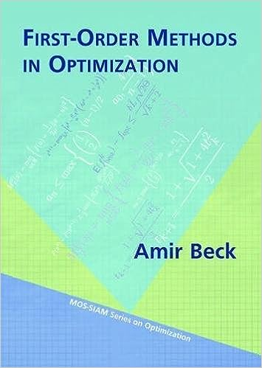
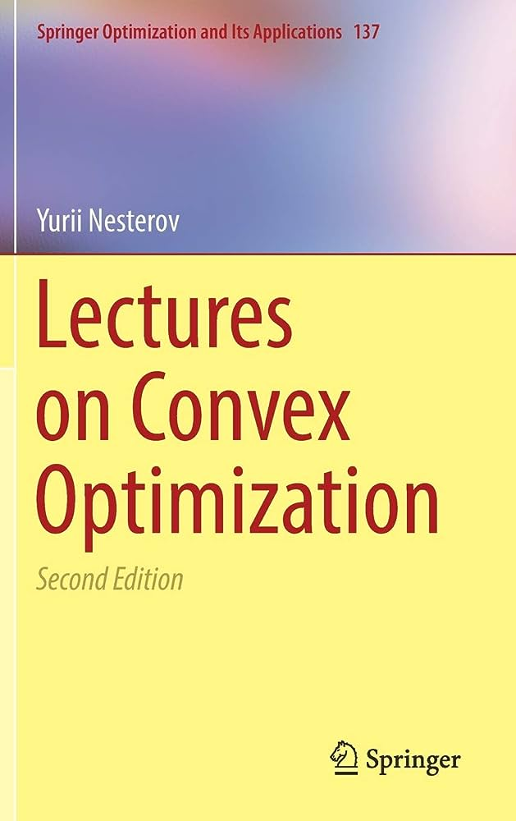
Textbooks
Amir Beck. First-order methods in optimization. SIAM, 2017.
Yurii Nesterov. Lectures on convex optimization. Springer, 2018.

Slide 7
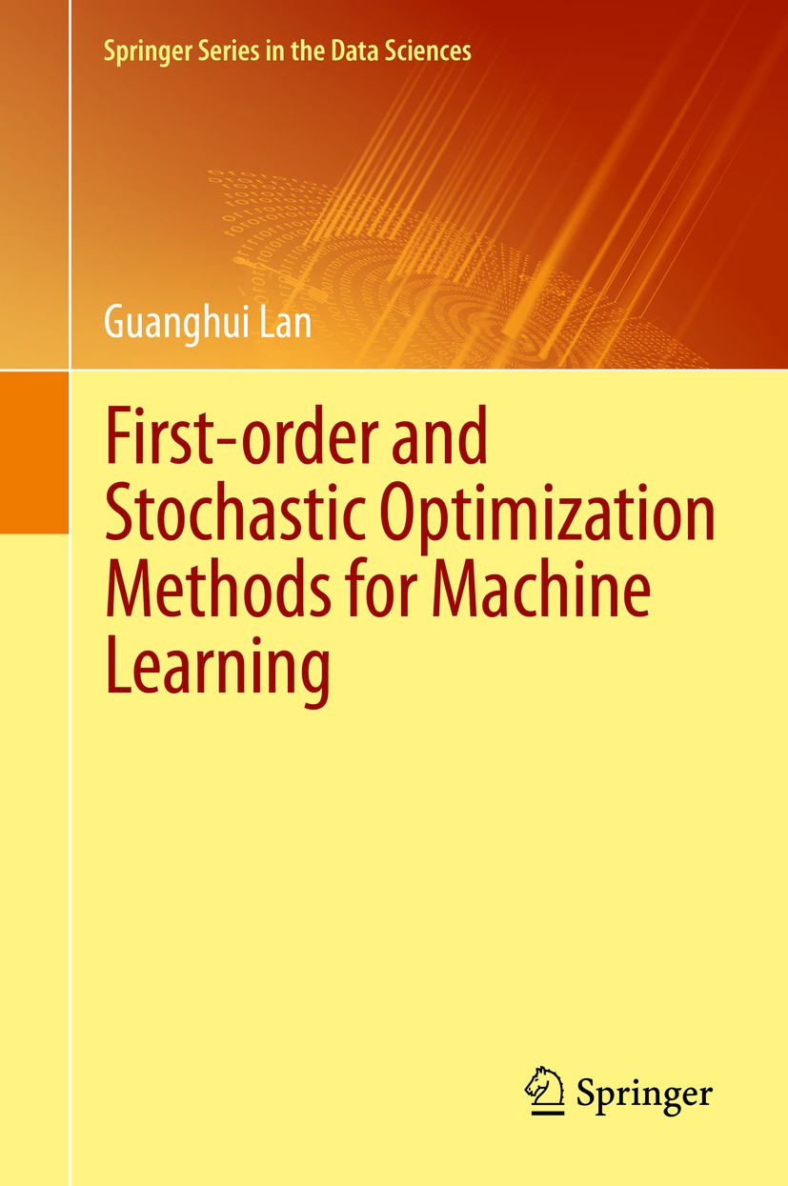
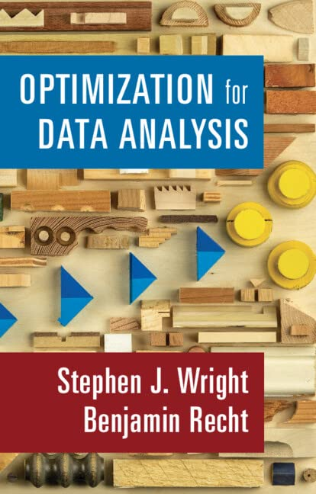
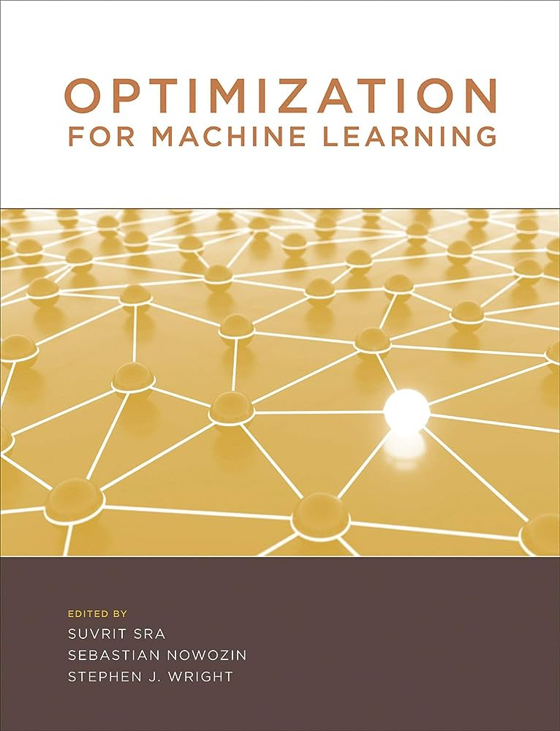
Recommended Readings
Guanghui Lan. First-order and Stochastic Optimization Methods for Machine Learning. Springer, 2020.
Benjamin Recht and Stephen Wright. Optimization for Data Analysis. Cambridge, 2022.
Optimization for Machine Learning. MIT, 2011. (Survey book)

Slide 8
Topics (tentative)
Introduction
  Applications in ML
  Convex analysis and complexity analysis
First-order methods I: basic concepts
  Gradient method
  Subgradient method
  Mirror descent
  Proximal gradient method
  Accelerated gradient method
  Frank-Wolfe method

Slide 9
First-order methods II: advanced topics
  Dual methods
  Operator splitting
  Universal methods
  Optimization in relative scale
Beyond first-order methods
  Second-order methods
  Higher-order methods
Selected topics in ML
  Stochastic optimization
  Distributionally robust optimization
  Distributed optimization
  Online learning
  Reinforcement learning

Slide 10
Project
An in-depth exploration of a topic in modern optimization methods
  A survey of a topic covered in class or choose your own
  Implementation of algorithms applied on an interesting application
  New ideas on research, bring your own research project + techniques from this course
Timeline
  Short abstract, mid-October (not graded)
  Proposal, November 5, 5%
  Presentation, December 5, 10%
  Report, December 10, 10%
Group of 1 or 2 members

Slide 11
Course Policy
Students are strongly encouraged to discuss homework problems with one another. However, each student must write up and turn in their own solutions, written in their own words/consisting of their own code.
Late submission of homework will not be accepted in the absence of a prior agreement between the student and instructor.
Instructors, teaching assistants, and students should work together to ensure that our class is a welcoming, inclusive, respectful, and vibrant place for all of its members to share, learn, and grow.
I am glad to meet to discuss your specific situation or to help ensure you have the support you need.

Slide 12
Introduction to Optimization

Slide 13
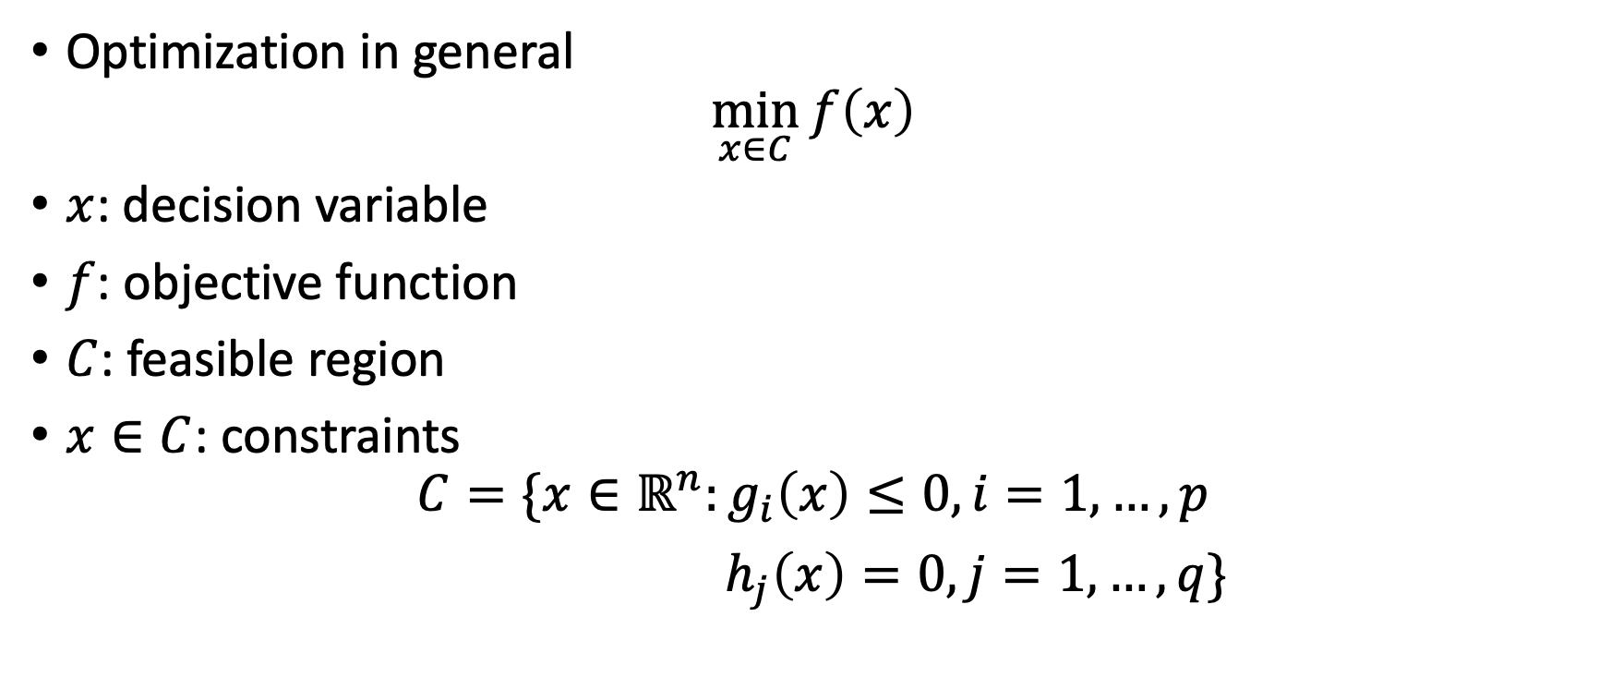
Optimization Program
Optimization in general
$$\min_{x∈C}{f\left(x\right)}$$
$x$: decision variable
$f$: objective function
$C$: feasible region
$x∈C$: constraints
$$C=\{x∈ℝ^{n}:g_{i}\left(x\right)≤0, i=1,…,p$$
$h_{j}\left(x\right)=0, j=1,…, q\}$

Slide 14


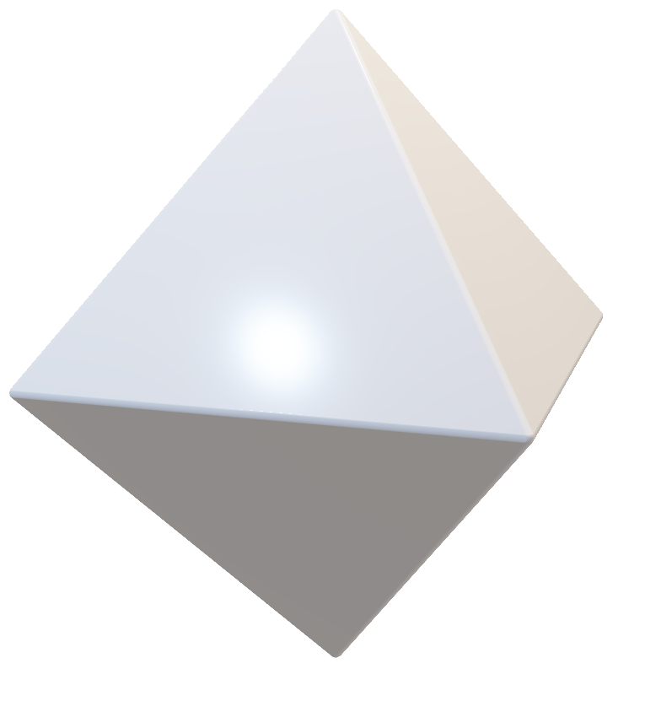


Feasible Region
$C=B_{2}^{n}\left(a,r\right)$, ball constraint
  Ridge regression
${C=B}_{1}^{n}\left(a,r\right)$, sparsity constraint
  Lasso
${C=B}_{∞}^{n}\left(a,r\right)$, box constraint
  Imaging problem
$C=\{x:Ax≤b\}$, polyhedron
  Linear programming

Slide 15

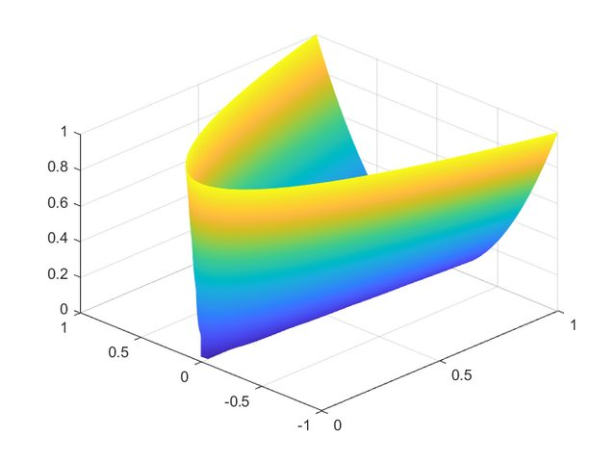
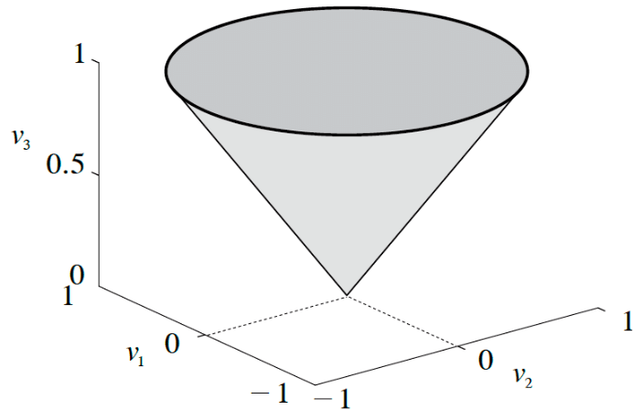
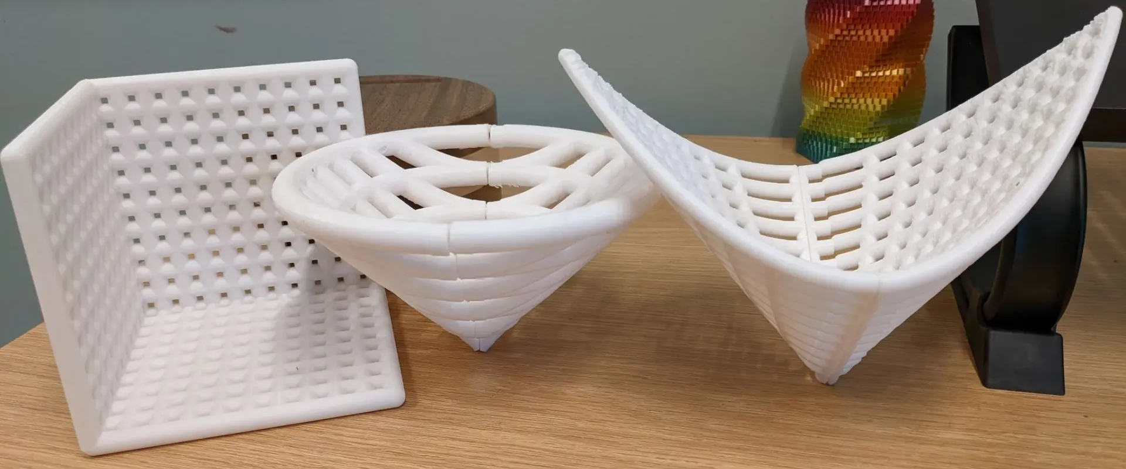

Feasible Region
$C=ℝ_{+}^{n}≔\left\{x∈ℝ^{n}:x_{j}≥0, j=1,…,n\right\}$
nonnegative orthant
  Nonnegative least square/matrix factorization
$C=Q^{n}≔\{x∈ℝ^{n}:x_{1}^{2}+…x_{n−1}^{2}≤x_{n}^{2}\}$,
second-order cone, Lorentz cone, or the ice-cream cone
  Second-order cone programming
$C=S_{+}^{n×n}≔\{X∈S^{n×n}:v^{⊤}Xv≥0 for all v∈ℝ^{n}\}$
semidefinite cone
  Semidefinite programming
Credit: Ben Grimmer

Slide 16
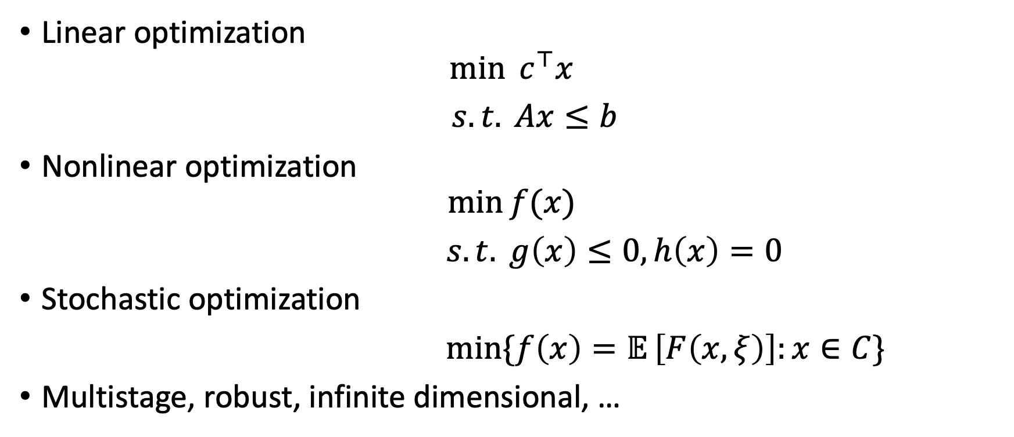
Types of Optimization Problems
Linear optimization
$$\min{{ c}^{⊤}x}$$
$s.t. Ax≤b$
Nonlinear optimization
$$\min{f(x)}$$
$s.t. g\left(x\right)≤0, h\left(x\right)=0$
Stochastic optimization
$\min{\{f\left(x\right)=𝔼}\left[F\left(x,ξ\right)\right]:x∈C\}$
Multistage, robust, infinite dimensional, …

Slide 17
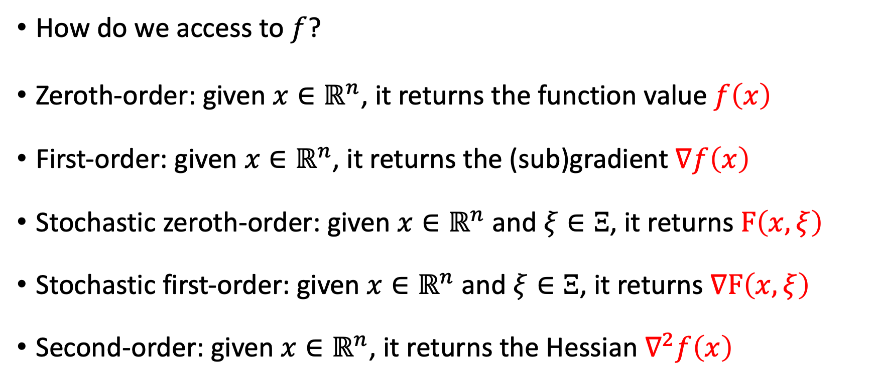
Black-box Oracles
This course mainly focuses on first-order methods using zeroth and first-order oracles. We will briefly discuss second and higher-order methods as well.
How do we access to $f$?
Zeroth-order: given $x∈ℝ^{n}$, it returns the function value $f\left(x\right)$
First-order: given $x∈ℝ^{n}$, it returns the (sub)gradient $∇f\left(x\right)$
Stochastic zeroth-order: given $x∈ℝ^{n}$ and $ξ∈Ξ$, it returns $F\left(x,ξ\right)$
Stochastic first-order: given $x∈ℝ^{n}$ and $ξ∈Ξ$, it returns $∇F\left(x,ξ\right)$
Second-order: given $x∈ℝ^{n}$, it returns the Hessian $∇^{2}f\left(x\right)$

Slide 18
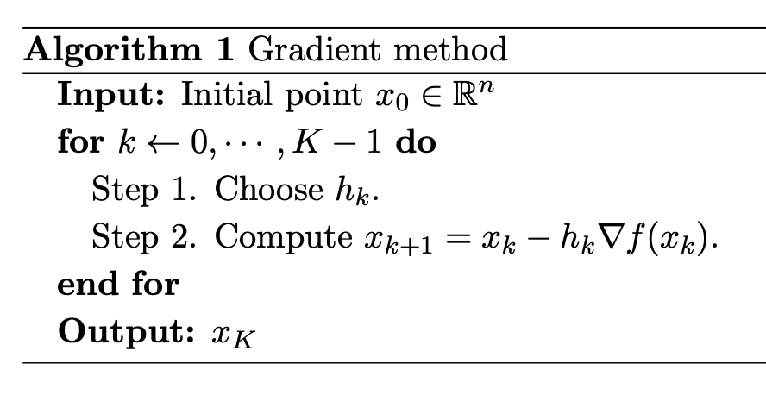
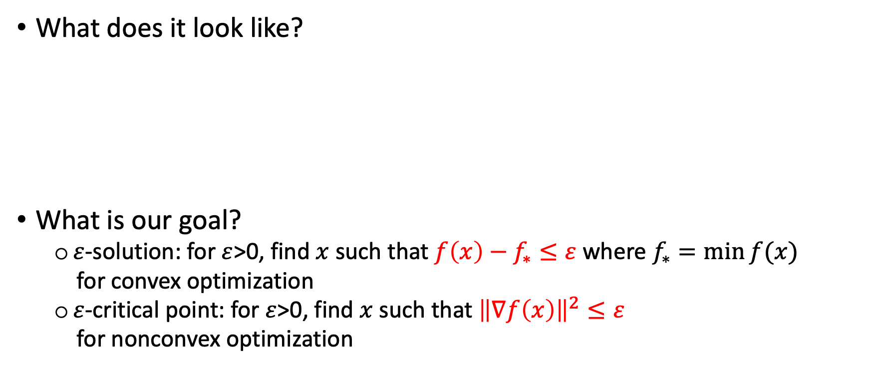
Optimization Algorithms
What does it look like?
What is our goal?
  $ε$-solution: for $ε$>0, find $x$ such that $f\left(x\right)−f_{∗}≤ε$ where $f_{∗}=\min{f(x)}$
  for convex optimization
  $ε$-critical point: for $ε$>0, find $x$ such that ${\left\|∇f\left(x\right)\right\|}^{2}≤ε$
  for nonconvex optimization

Slide 19
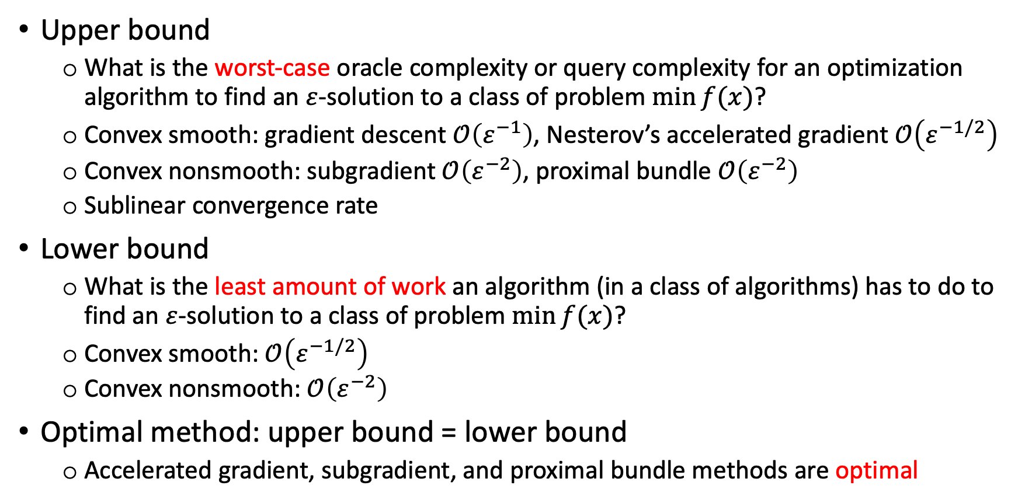
Complexity Analysis
Upper bound
  What is the worst-case oracle complexity or query complexity for an optimization algorithm to find an $ε$-solution to a class of problem $\min{f(x)}$?
  Convex smooth: gradient descent $𝒪\left(ε^{−1}\right)$, Nesterov’s accelerated gradient $𝒪\left(ε^{−1/2}\right)$
  Convex nonsmooth: subgradient $𝒪\left(ε^{−2}\right)$, proximal bundle $𝒪\left(ε^{−2}\right)$
  Sublinear convergence rate
Lower bound
  What is the least amount of work an algorithm (in a class of algorithms) has to do to find an $ε$-solution to a class of problem $\min{f(x)}$?
  Convex smooth: $𝒪\left(ε^{−1/2}\right)$
  Convex nonsmooth: $𝒪\left(ε^{−2}\right)$
Optimal method: upper bound = lower bound
  Accelerated gradient, subgradient, and proximal bundle methods are optimal

Slide 20
Development of Optimization Methods

Slide 21
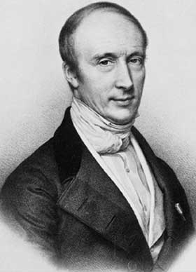
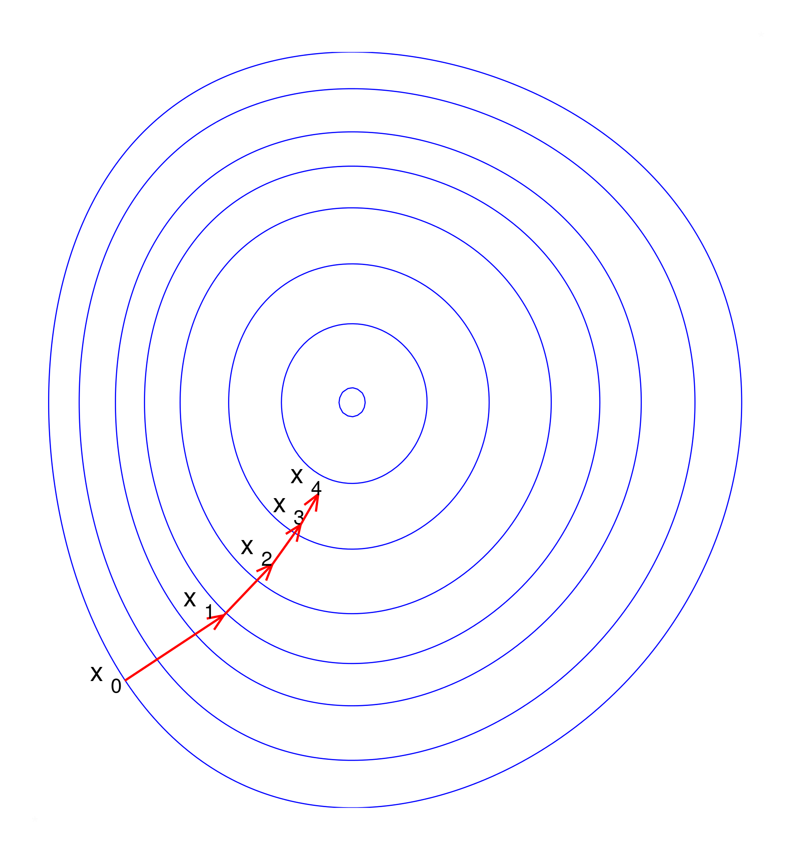
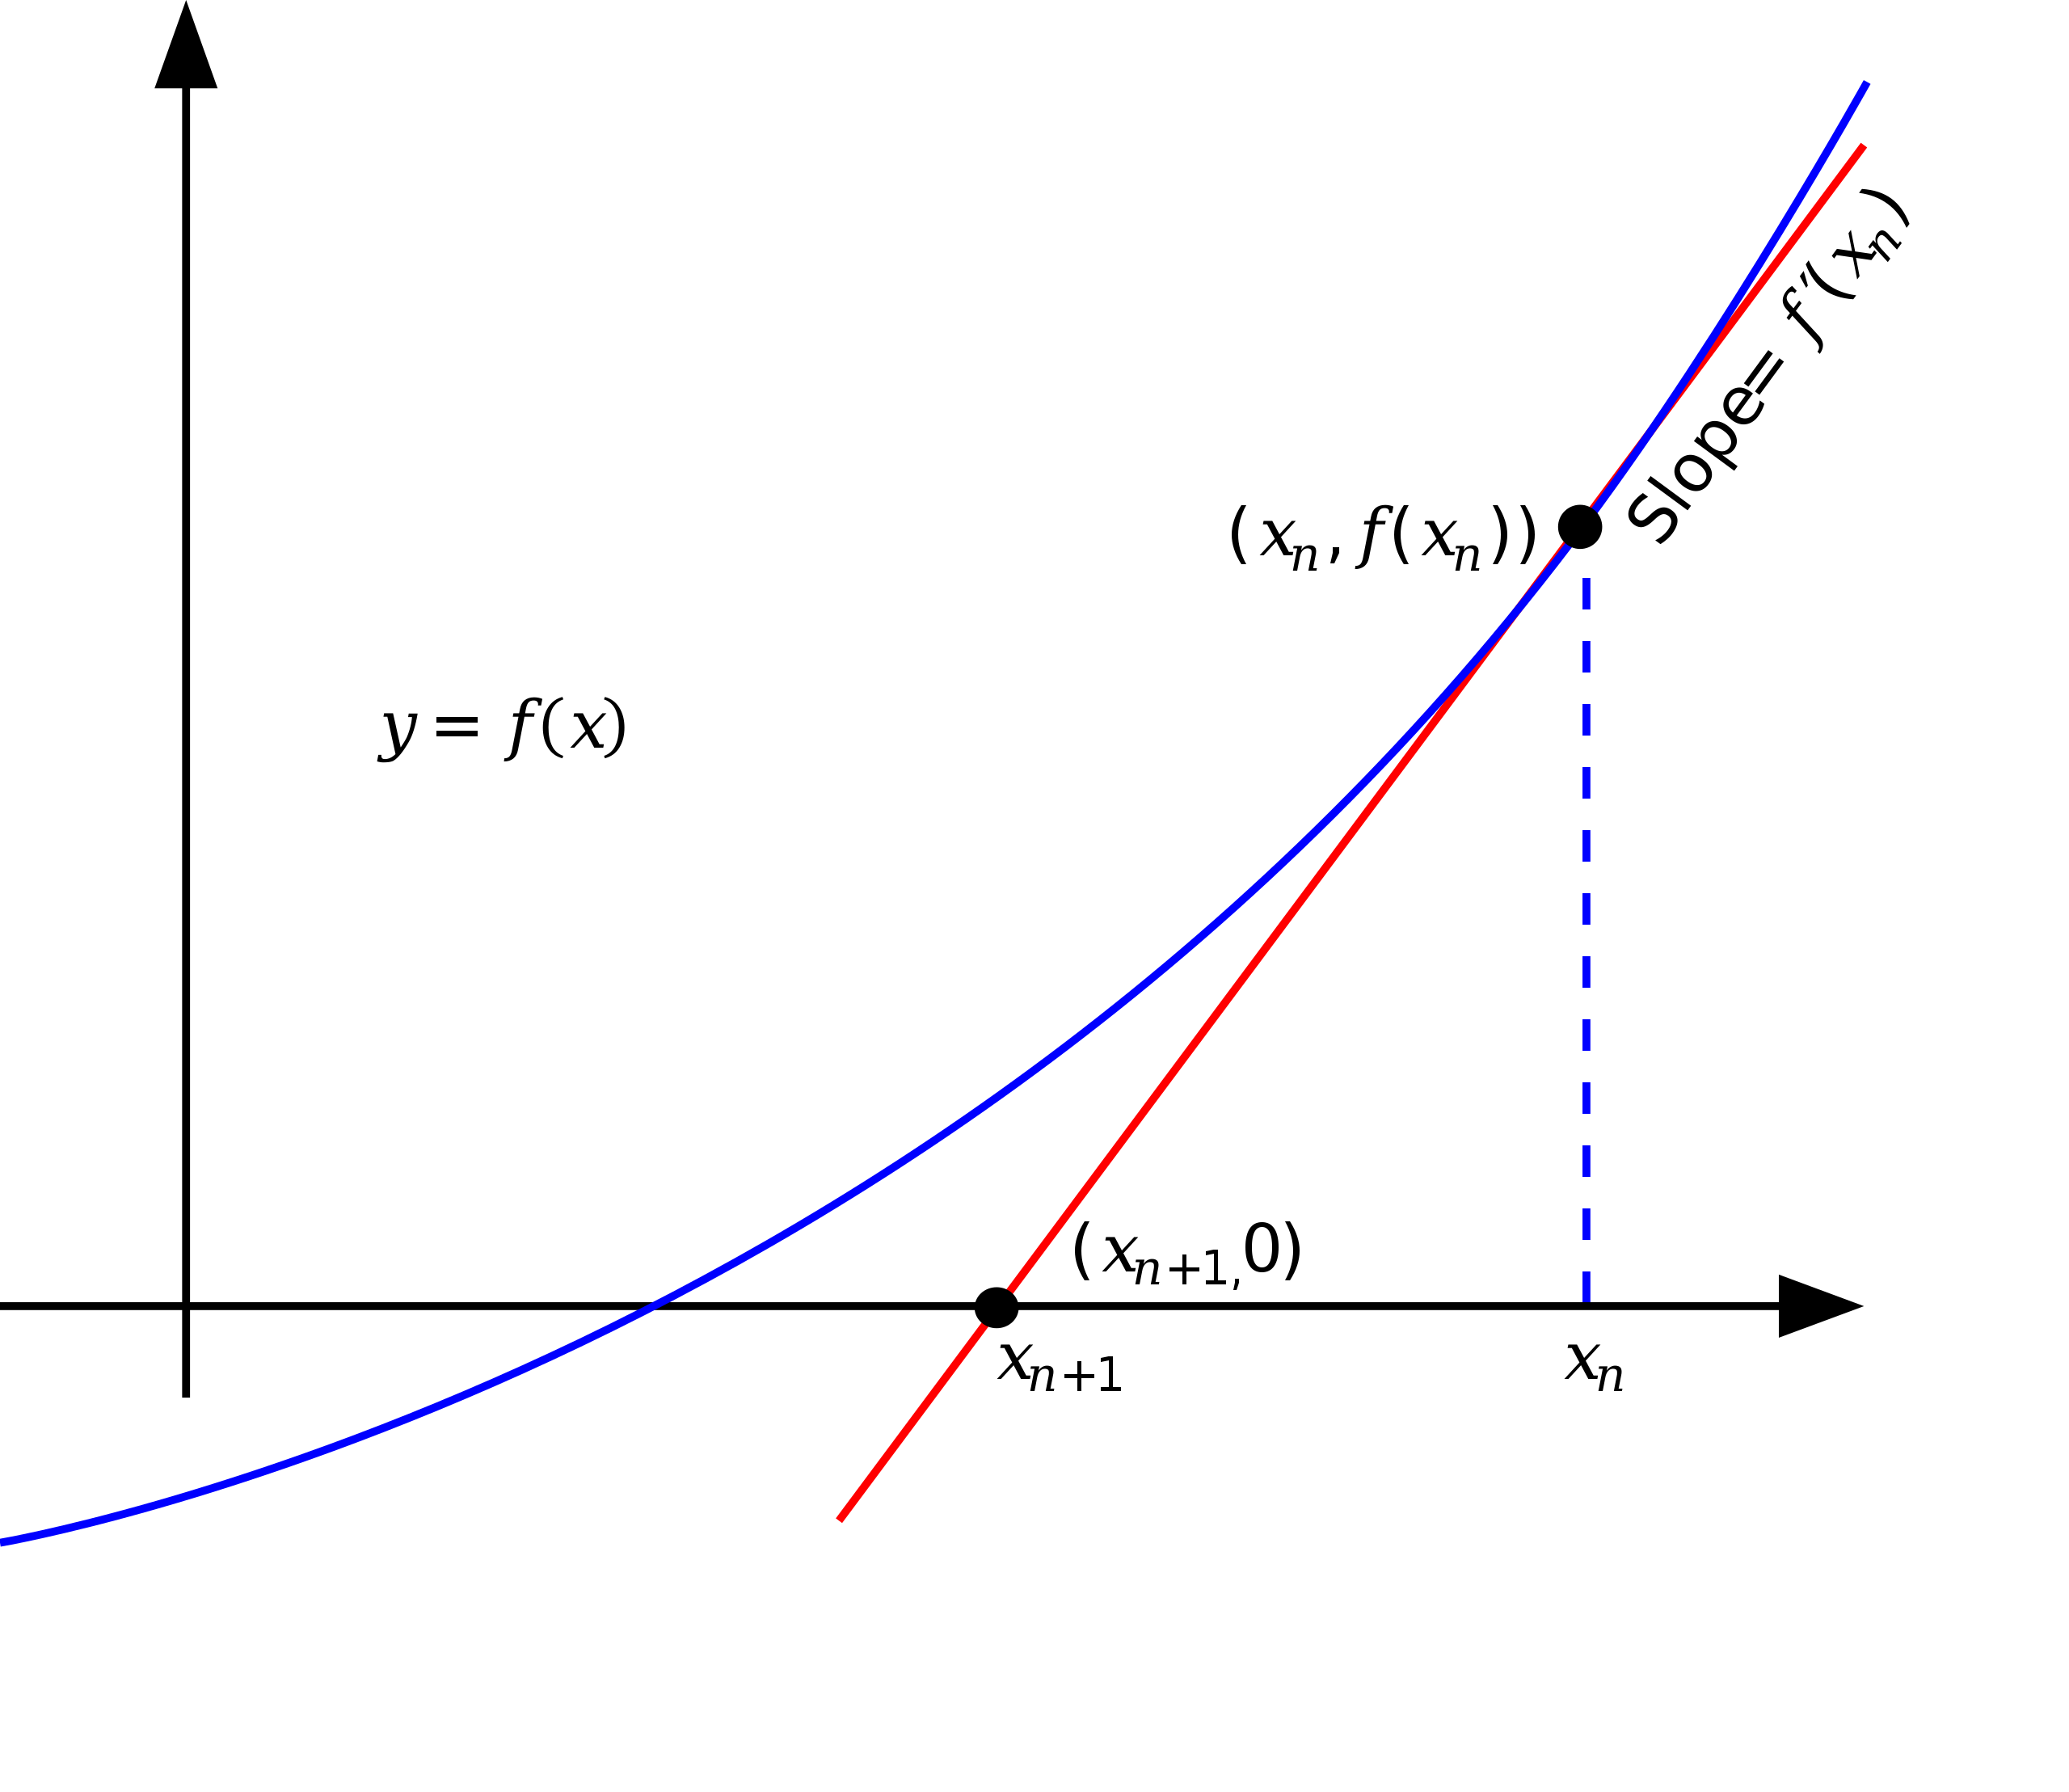
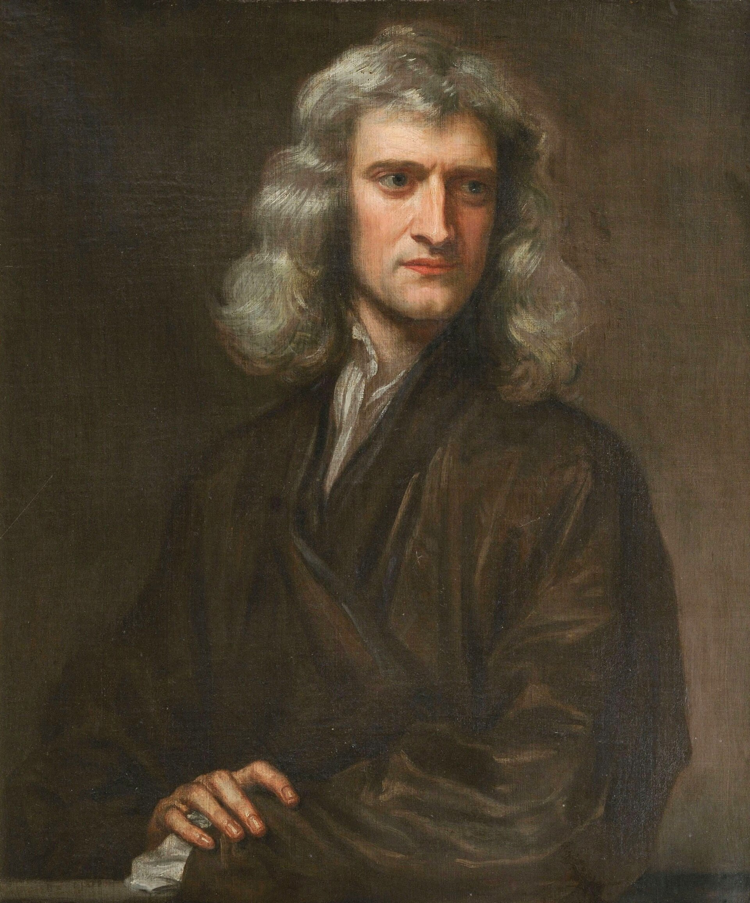
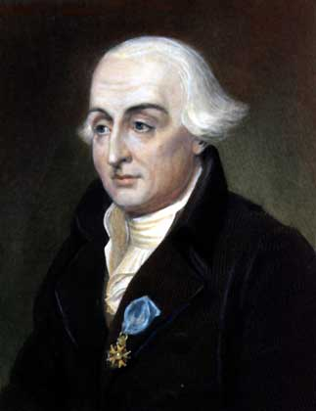
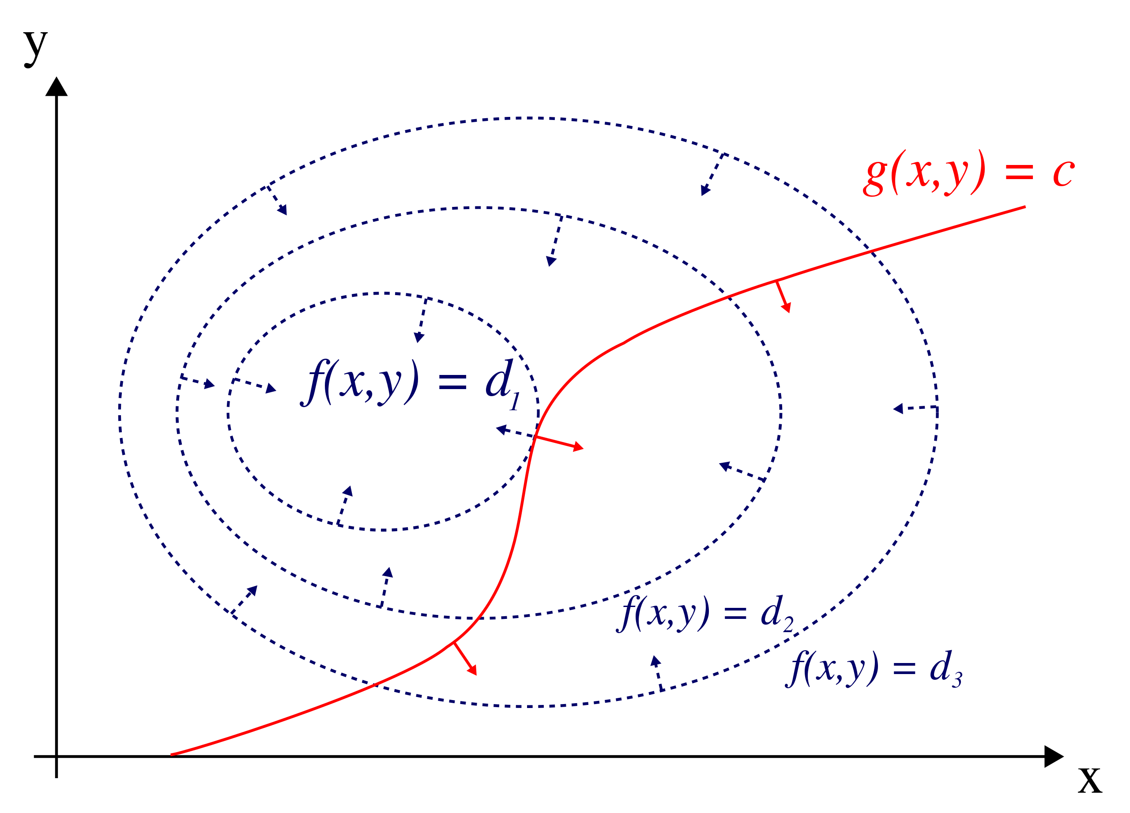
Optimization in the early times
Gradient descent
Newton’s method
Lagrange multiplier
Cauchy
Newton
Lagrange

Slide 22
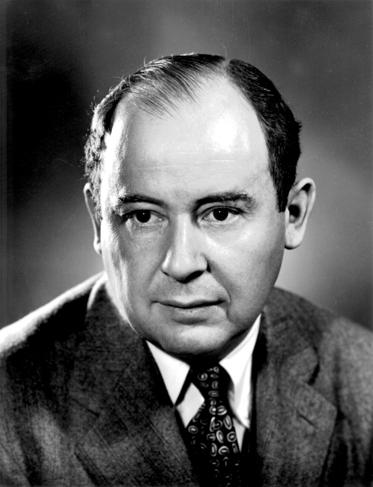
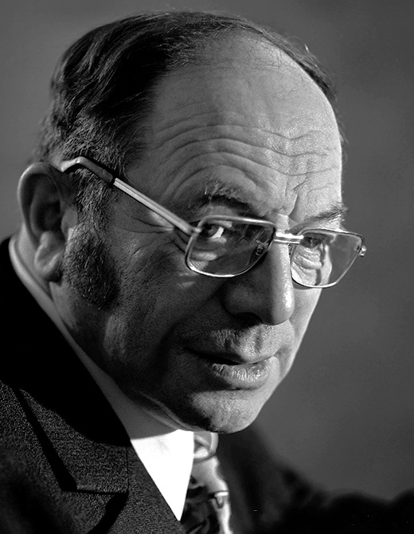
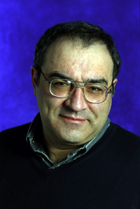
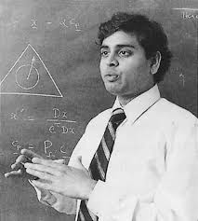
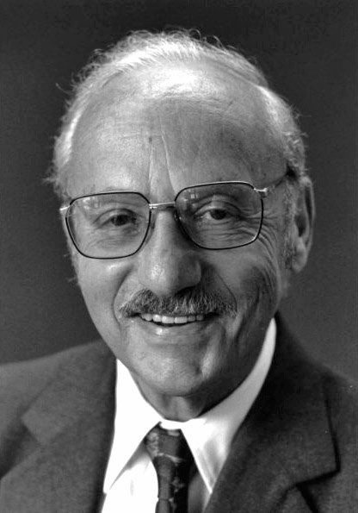
Optimization in the 20th century
Linear programming (1940s), simplex method
Ellipsoid method (1970s)
Interior point method (1980s)
von Neumann
Kantorovich
Khachiyan
Karmarkar
Dantzig

Slide 23
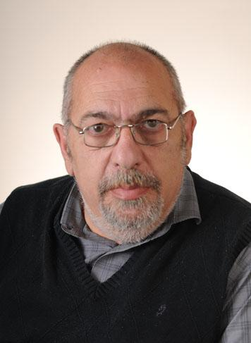

Optimization in the modern times
Revisit of old methods
  Frank-Wolfe (1956)
  ADMM (1956,1970s)
  Fast gradient (1983)
Development of new methods
  Smoothing (2005)
  Dual averaging (2005)
  FISTA (2009)
  Randomized coordinate descent (2010)
  Higher-order (2018+)
Nemirovski
Nesterov

Slide 24
Applications of OPT in ML

Slide 25
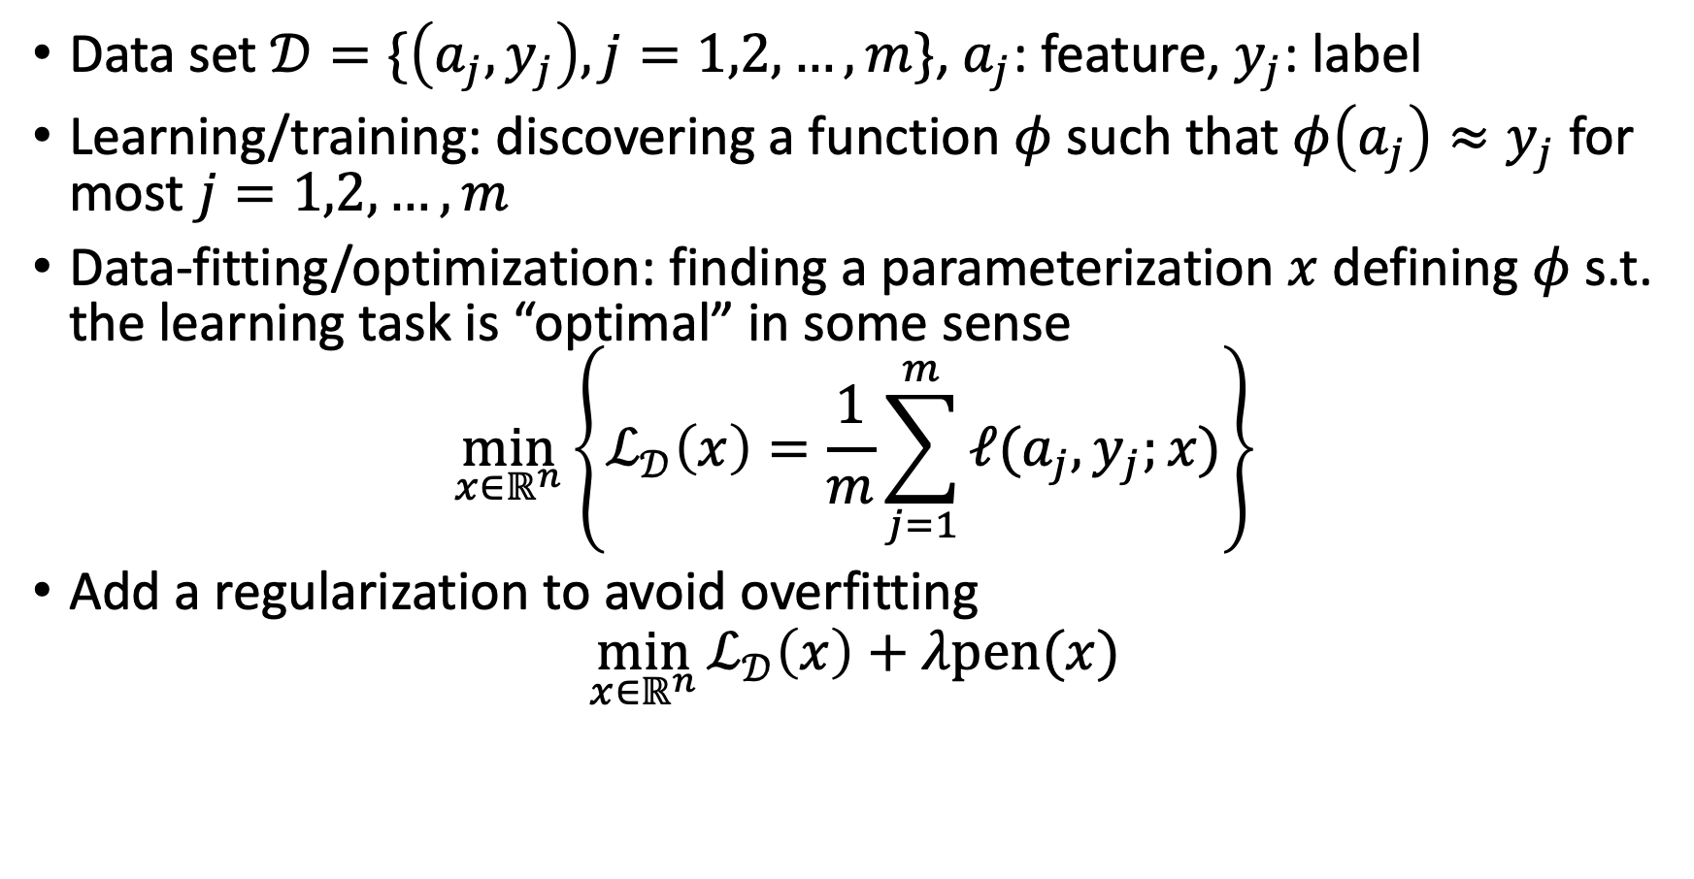
Data Analysis and Optimization
Data set $𝒟=\{\left(a_{j},y_{j}\right), j=1,2,…,m\}$, $a_{j}$: feature, $y_{j}$: label
Learning/training: discovering a function $φ$ such that $φ\left(a_{j}\right)≈y_{j}$ for most $j=1,2,…,m$
Data-fitting/optimization: finding a parameterization $x$ defining $φ$ s.t. the learning task is “optimal” in some sense
$$\min_{x∈ℝ^{n}}\left\{ℒ_{𝒟}\left(x\right)=\frac{1}{m}\sum_{j=1}^{m}{ℓ(a_{j},y_{j};x)}\right\}$$
Add a regularization to avoid overfitting
$$\min_{x∈ℝ^{n}}{ℒ_{𝒟}\left(x\right)+λ\text{pen}(x)}$$

Slide 26
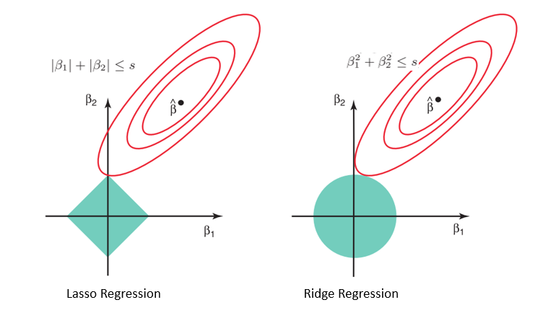
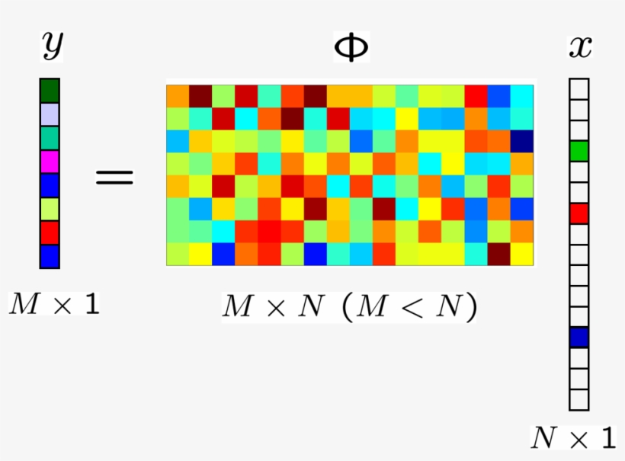
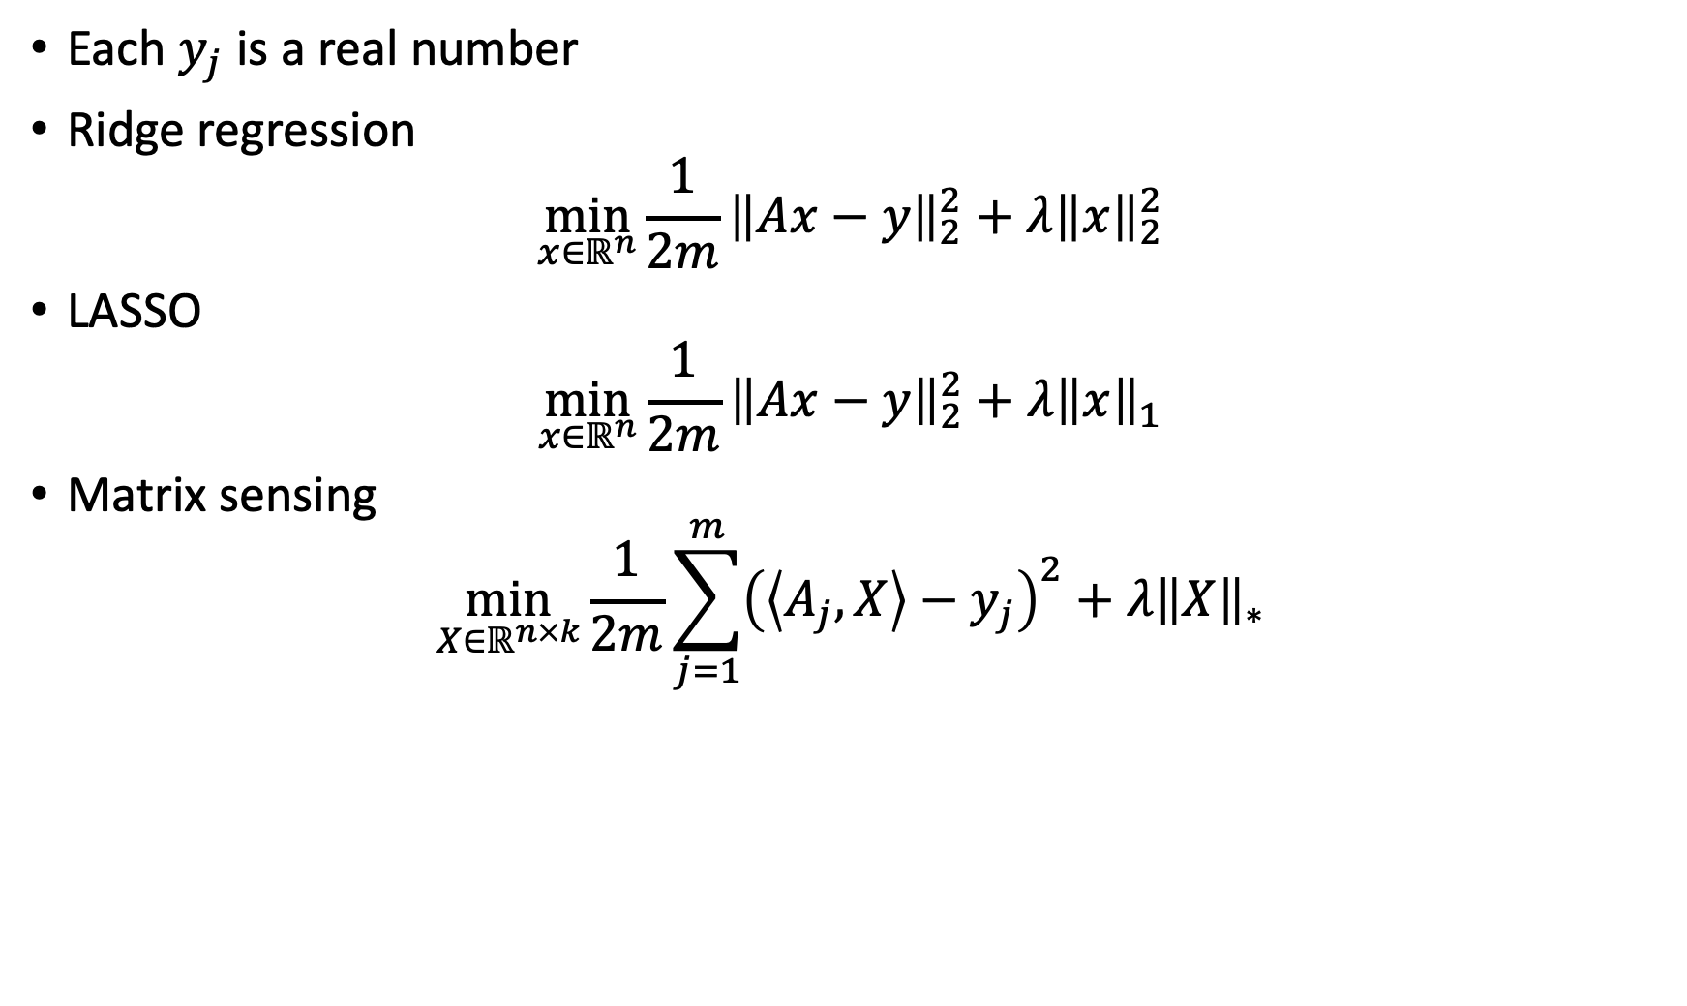
Regression
Each $y_{j}$ is a real number
Ridge regression
$$\min_{x∈ℝ^{n}}{\frac{1}{2m}{\left\|Ax−y\right\|}_{2}^{2}+λ{\left\|x\right\|}_{2}^{2}}$$
LASSO
$$\min_{x∈ℝ^{n}}{\frac{1}{2m}{\left\|Ax−y\right\|}_{2}^{2}+λ{\left\|x\right\|}_{1}}$$
Matrix sensing
$$\min_{X∈ℝ^{n×k}}{\frac{1}{2m}\sum_{j=1}^{m}{{\left(\left\langle A_{j},X\right\rangle −y_{j}\right)}^{2}}+λ{\left\|X\right\|}_{∗}}$$

Slide 27
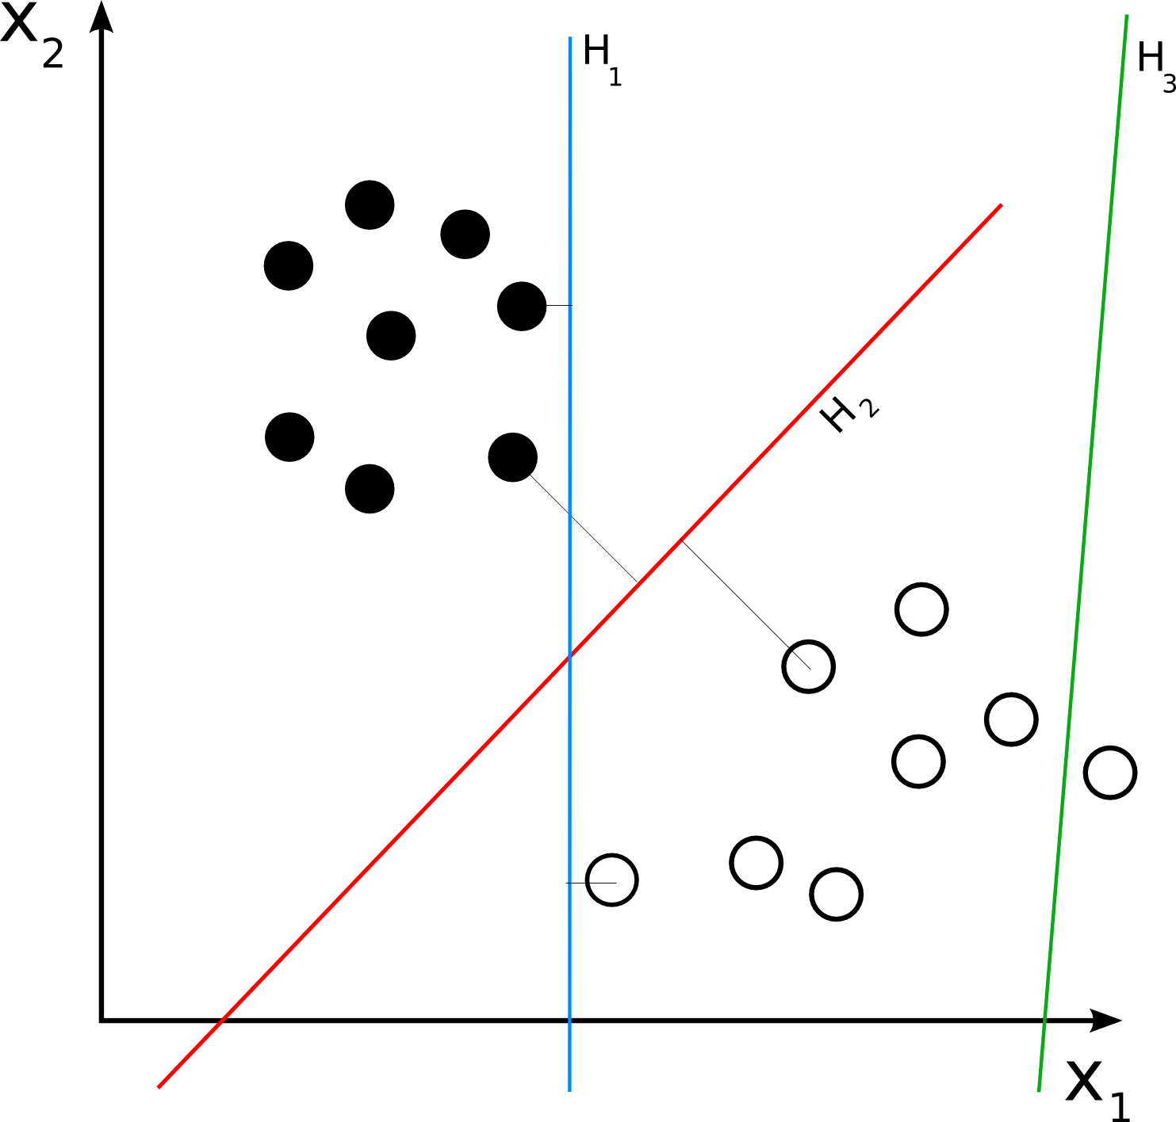
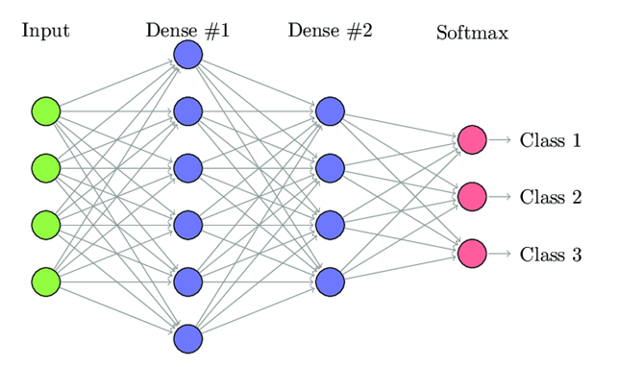
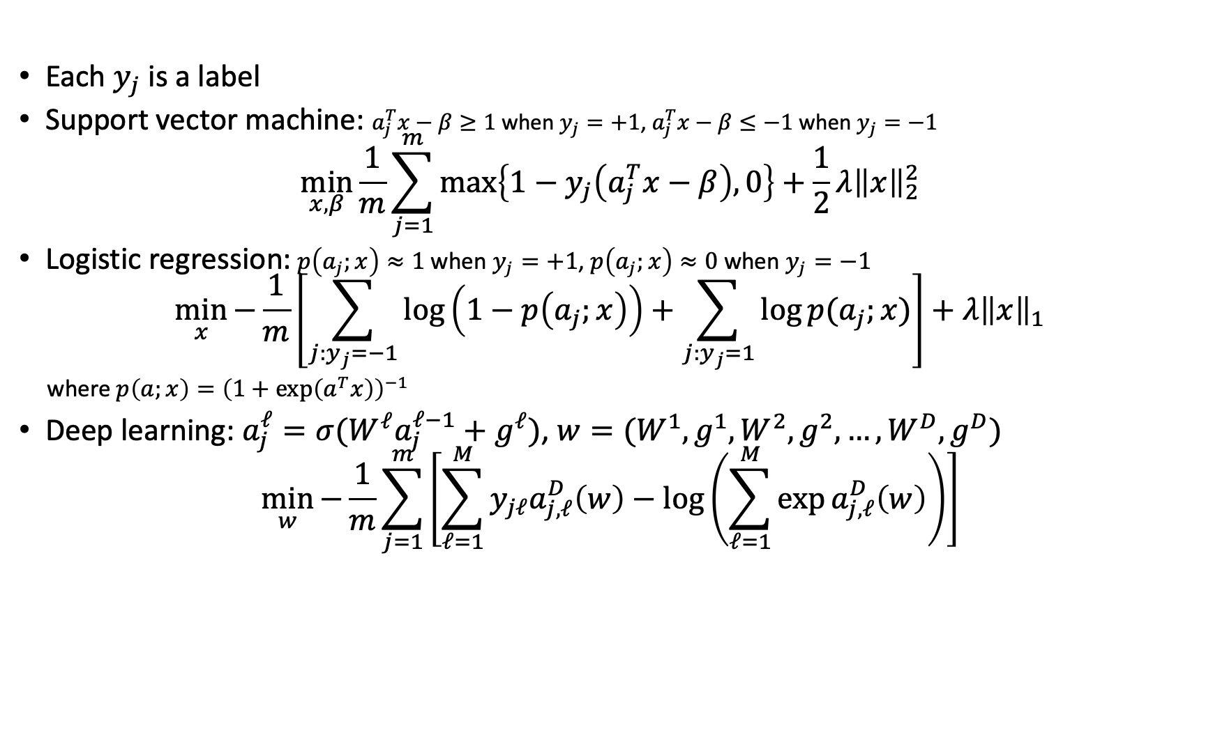
Classification
Each $y_{j}$ is a label
Support vector machine: $a_{j}^{T}x−β≥1$ when $y_{j}=+1$, $a_{j}^{T}x−β≤−1$ when $y_{j}=−1$
$$\min_{x,β}{\frac{1}{m}\sum_{j=1}^{m}{\text{max}\left\{1−y_{j}\left(a_{j}^{T}x−β\right),0\right\}}+\frac{1}{2}λ{\left\|x\right\|}_{2}^{2}}$$
Logistic regression: $p\left(a_{j};x\right)≈1$ when $y_{j}=+1$, $p\left(a_{j};x\right)≈0$ when $y_{j}=−1$
$$\min_{x}{−\frac{1}{m}\left[\sum_{j:y_{j}=−1}{\log\left(1−p\left(a_{j};x\right)\right)+\sum_{j:y_{j}=1}{\log{p(a_{j};x)}}}\right]+λ{\left\|x\right\|}_{1}}$$
where $p\left(a;x\right)={\left(1+\text{exp}\left(a^{T}x\right)\right)}^{−1}$
Deep learning: $a_{j}^{ℓ}=σ(W^{ℓ}a_{j}^{ℓ−1}+g^{ℓ})$, $w=(W^{1},g^{1},W^{2},g^{2},…,W^{D},g^{D})$
$$\min_{w}{−\frac{1}{m}}\sum_{j=1}^{m}{\left[\sum_{ℓ=1}^{M}{y_{jℓ}a_{j,ℓ}^{D}\left(w\right)−\log\left(\sum_{ℓ=1}^{M}{\exp{a_{j,ℓ}^{D}\left(w\right)}}\right)}\right]}$$

Slide 28
More Applications
Generative adversarial network
  saddle-point, min-max optimization
Sinkhorn algorithm for entropy-regularised optimal transport
  proximal point method
Follow-the-regularized-leader (FTRL) in online learning
  mirror descent
Reinforcement learning
  policy gradient, Markov decision process (MDP)
More in future lectures and course project

Slide 29
Thank you!

