Slide 1
CSC 246 Machine Learning
Fall 2026
Jiaming Liang
GIDS-AI/Department of Computer Science
University of Rochester
September 1, 2026

Slide 2
Course Information
Time: Tuesday & Thursday, 3:25 – 4:40 pm
Location: Gavett Hall 206
Instructor: Jiaming Liang
Teaching Assistant: Tung Lam Tran
Blackboard
Website: https://jiaming-liang.github.io/ML.html
Office hour: 3:00-4:00 pm on Wednesday, Wegmans 2403 (Jiaming)
4:00-5:00 pm on Monday, Wegmans 4209 (Lam)

Slide 3
Instructor – Jiaming Liang
Assistant professor in Data Science and Computer Science
Wegmans Hall 2403
jiaming.liang@rochester.edu
Ph.D. in Operations Research, Georgia Tech
Postdoc in Computer Science, Yale
Research interests: nonsmooth optimization, stochastic optimization, sampling algorithms

Slide 4
Teaching Assistant – Tung Lam Tran
PhD Student in Computer Science
ttran53@ur.rochester.edu
Office hour: 4:00-5:00 pm on Monday, Wegmans Hall 4209

Slide 5
Grading
6 Problem sets x 5% = 30% (every other Thur., starting from Sep. 10)
In-class midterm 25% (Oct. 15)
In-class quiz 15% (Nov. 19)
Final exam 30% (Dec. 21)

Slide 6
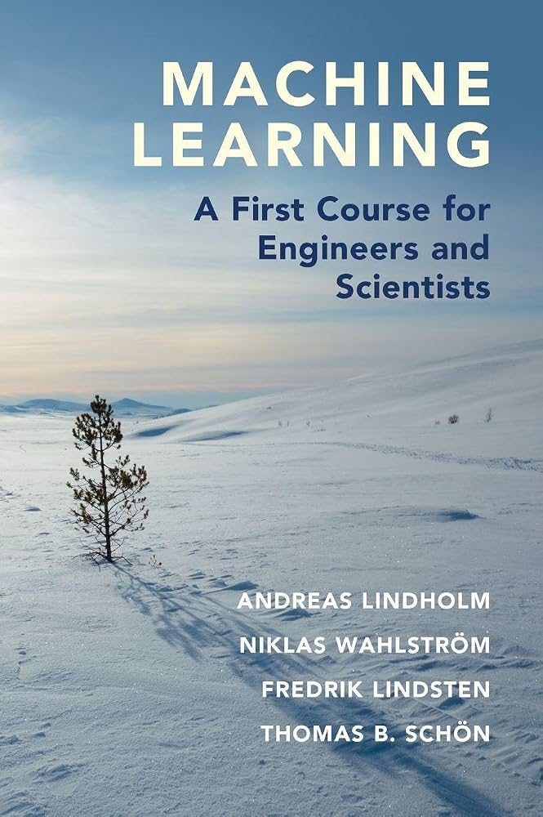
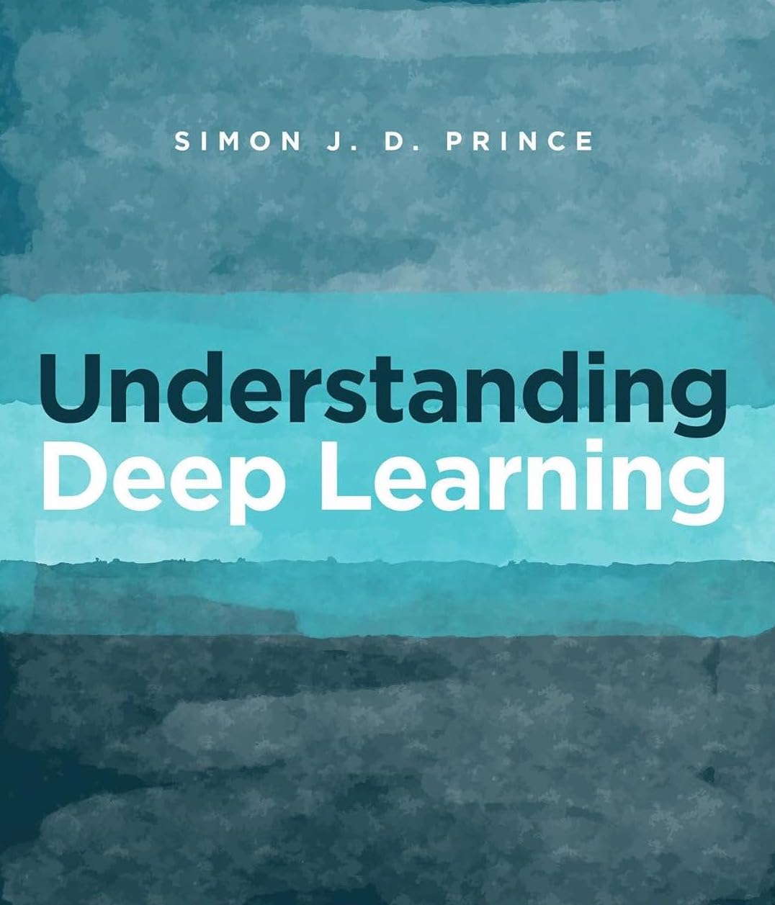
Textbooks
Andreas Lindholm, Niklas Wahlstrom, Fredrik Lindsten, and Thomas B. Schon. Machine Learning: A First Course for Engineers and Scientists. Cambridge University Press, 2022.
Simon J. D. Prince. Understanding Deep Learning. MIT Press, 2023.

Slide 7
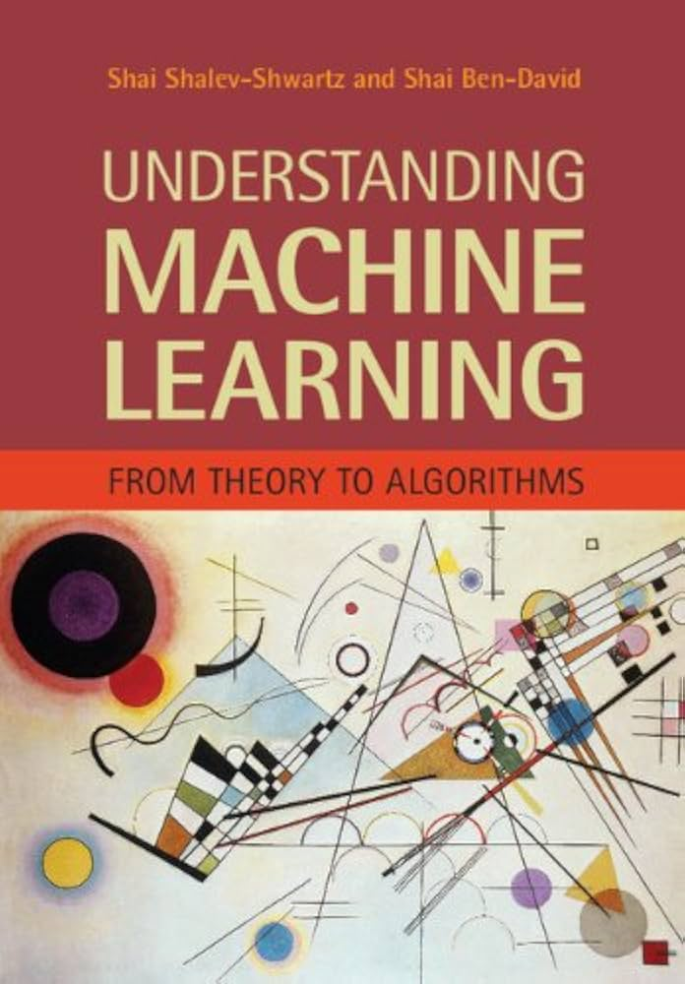
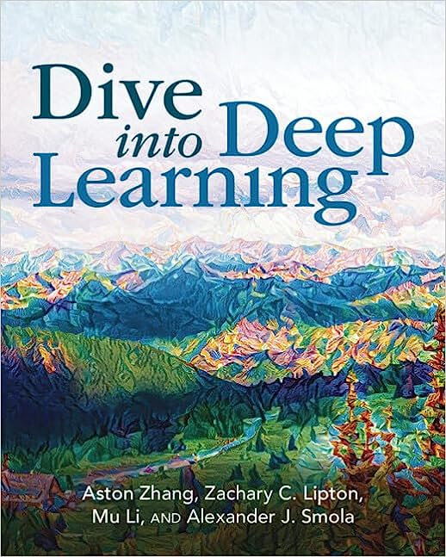
Recommended Readings
Shai Shalev-Shwartz and Shai Ben-David. Understanding Machine Learning: From Theory to Algorithms. Cambridge University Press, 2014.
Aston Zhang, Zachary C. Lipton, Mu Li, and Alexander J. Smola. Dive into Deep Learning. https://d2l.ai

Slide 8
Course Organization
Supervised Learning
empirical risk, regression, classification, regularization, SVM, kernels
Unsupervised Learning
PCA, clustering, Gaussian mixtures, EM
Deep learning
MLP, backpropagation, CNN, ResNet, attention, Transformer
Generative Models
autoencoder, VAE, GAN, diffusion, pre-training, fine-tuning
Reinforcement Learning
MDP, value function, Bellman equation, Q-learning, policy gradient, RLHF

Slide 9
Course Policy
Students are strongly encouraged to discuss homework problems with one another. However, each student must write up and turn in their own solutions, written in their own words/code.
Late submission of homework will not be accepted in the absence of a prior agreement between the student and instructor.
You may use AI tools to support your learning and problem solving in this course. If you use AI for an assignment, please briefly state what tool you used and how it helped you. You are responsible for understanding and verifying everything you submit. If you collaborate with other students, please do not share your AI chat history or AI-generated solutions with others.
Instructors, teaching assistants, and students should work together to ensure that our class is a welcoming, inclusive, respectful, and vibrant place for all of its members to share, learn, and grow.

Slide 10
What is Machine Learning?

Slide 11
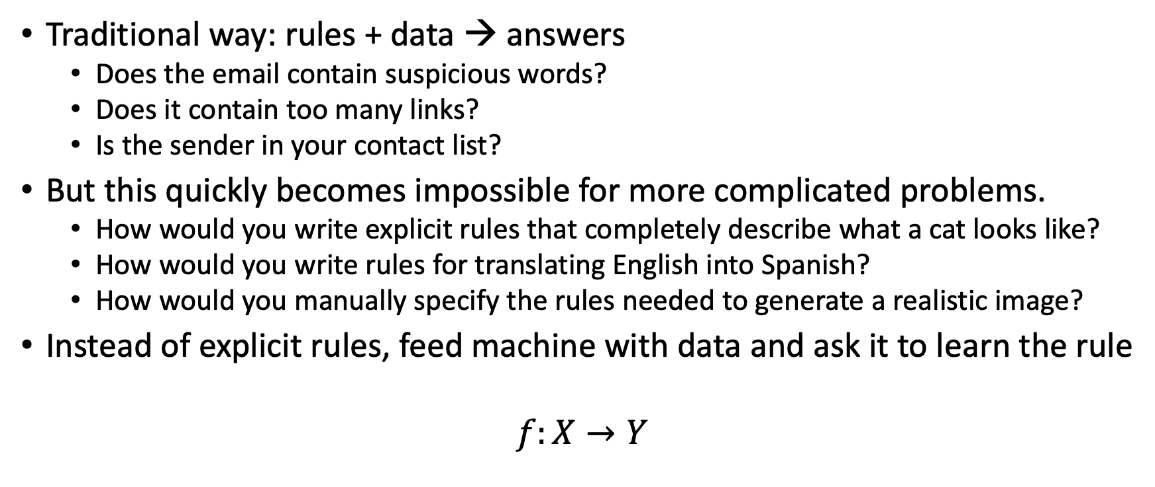
Determine whether an email is spam
Traditional way: rules + data → answers
  Does the email contain suspicious words?
  Does it contain too many links?
  Is the sender in your contact list?
But this quickly becomes impossible for more complicated problems.
  How would you write explicit rules that completely describe what a cat looks like?
  How would you write rules for translating English into Spanish?
  How would you manually specify the rules needed to generate a realistic image?
Instead of explicit rules, feed machine with data and ask it to learn the rule
$$f:X→Y$$

Slide 12
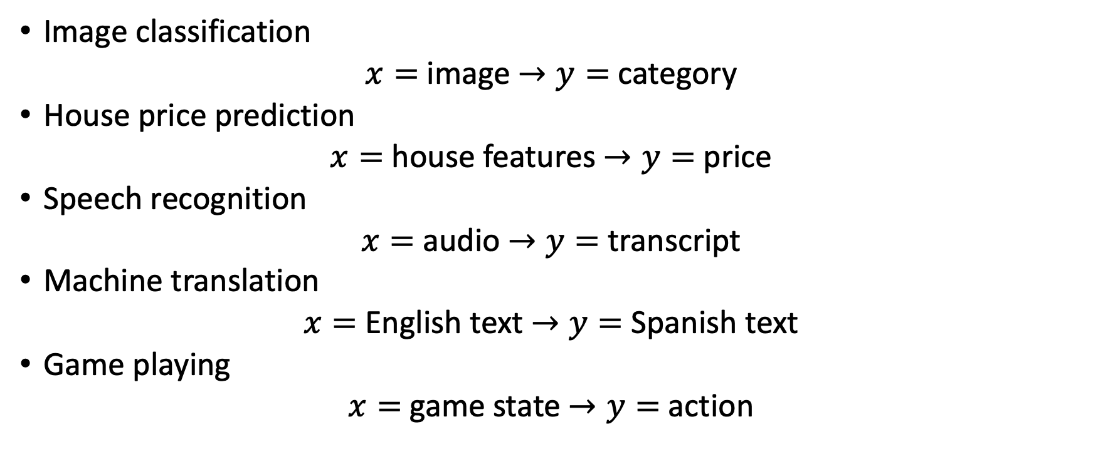
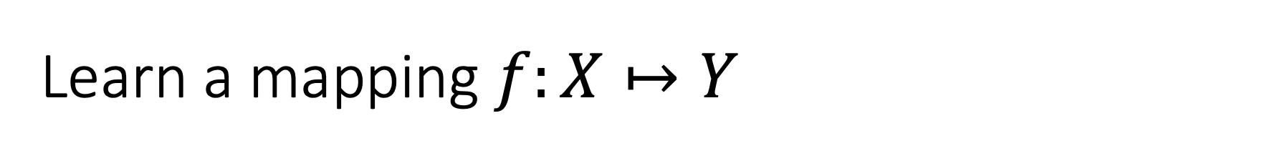
Learn a mapping $f:X↦Y$
Image classification
$x=$ image $→y=$ category
House price prediction
$x=$ house features $→y=$ price
Speech recognition
$x=$ audio $→y=$ transcript
Machine translation
$x=$ English text $→y=$ Spanish text
Game playing
$x=$ game state $→y=$ action

Slide 13
Learning Paradigms

Slide 14
Credit: Simon J. D. Prince

Slide 15
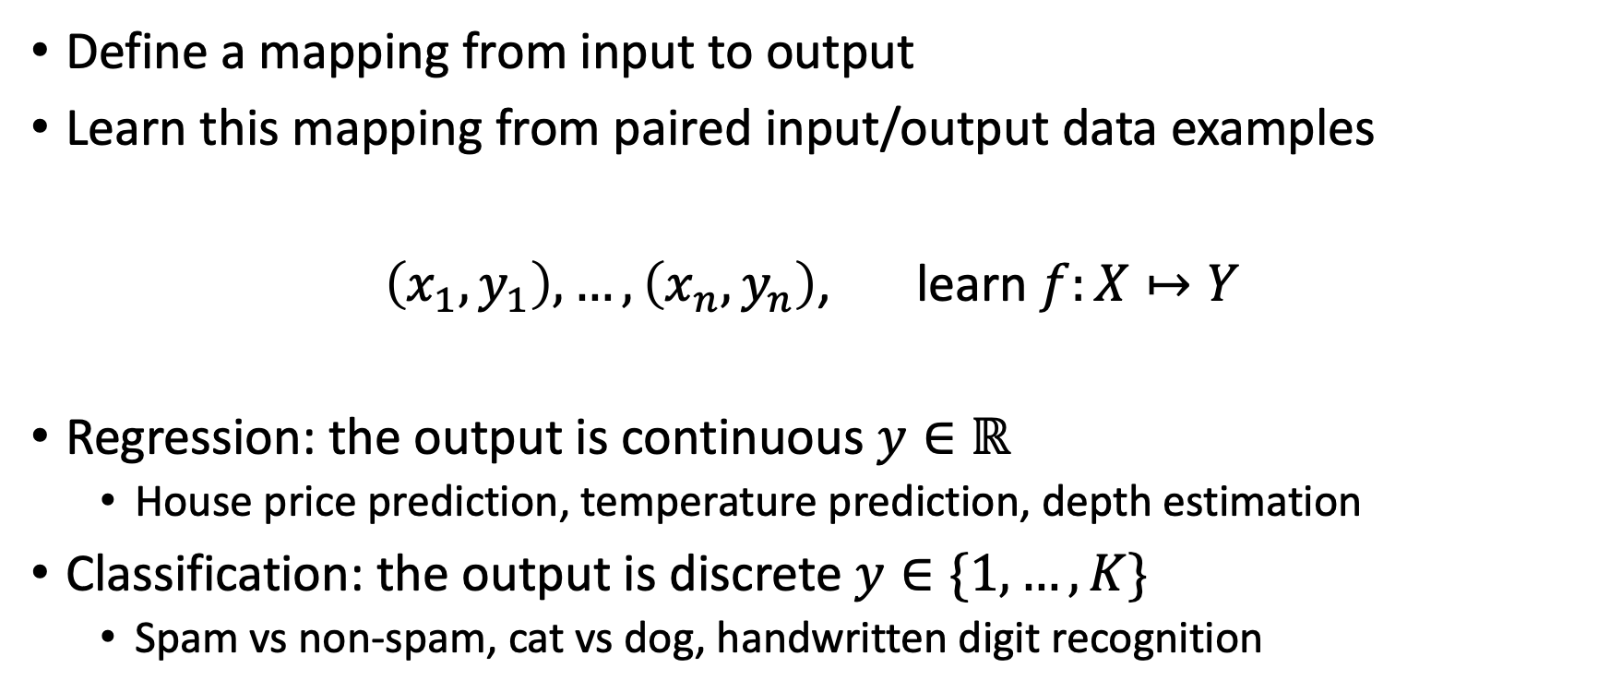
Supervised learning
Define a mapping from input to output
Learn this mapping from paired input/output data examples
$\left(x_{1},y_{1}\right), …,\left(x_{n},y_{n}\right)$, learn $f:X↦Y$
Regression: the output is continuous $y∈ℝ$
  House price prediction, temperature prediction, depth estimation
Classification: the output is discrete $y∈\{1,…,K\}$
  Spam vs non-spam, cat vs dog, handwritten digit recognition

Slide 16
Regression
Univariate regression problem (one output, real value)
Fully connected network

Slide 17
Graph regression
Multivariate regression problem (>1 output, real value)
Graph neural network

Slide 18
Text classification
Binary classification problem (two discrete classes)
Transformer network

Slide 19
Music genre classification
Multiclass classification problem (discrete classes, >2 possible values)
Recurrent neural network (RNN)

Slide 20
Image classification
Multiclass classification problem (discrete classes, >2 possible classes)
Convolutional network

Slide 21
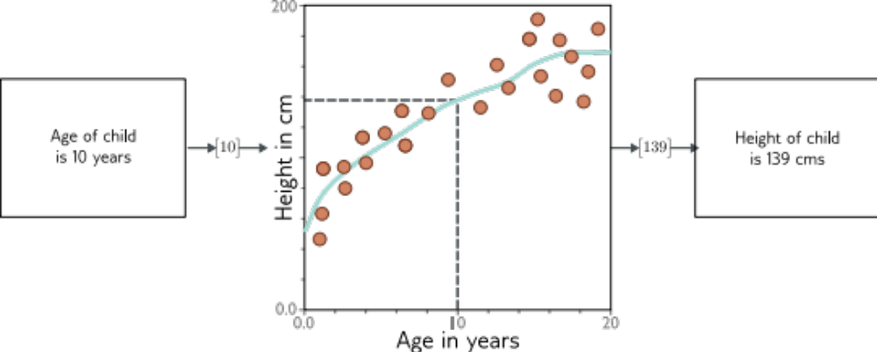
What is a supervised learning model?
An equation relating input (age) to output (height)
Search through family of possible equations to find one that fits training data well

Slide 22
What is a supervised learning model?
Deep neural networks are just a very flexible family of equations
Fitting deep neural networks = “Deep Learning”

Slide 23
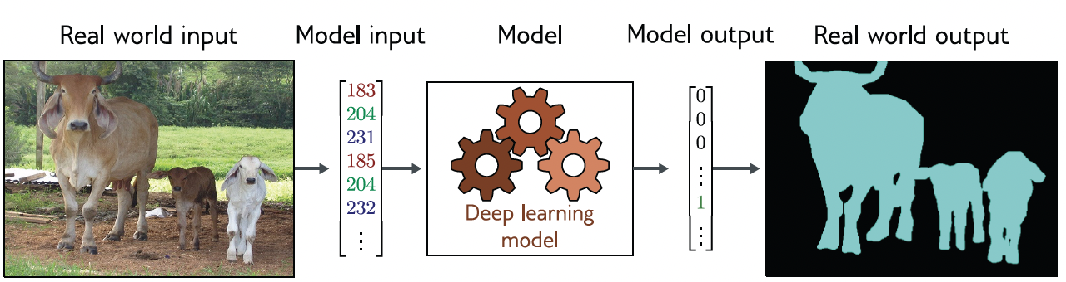
Image segmentation
Multivariate binary classification problem (many outputs, two discrete classes)
Convolutional encoder-decoder network

Slide 24
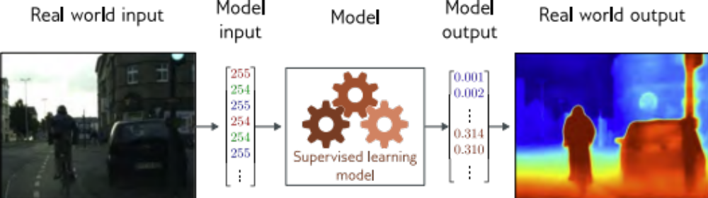
Depth estimation
Multivariate regression problem (many outputs, continuous)
Convolutional encoder-decoder network

Slide 25
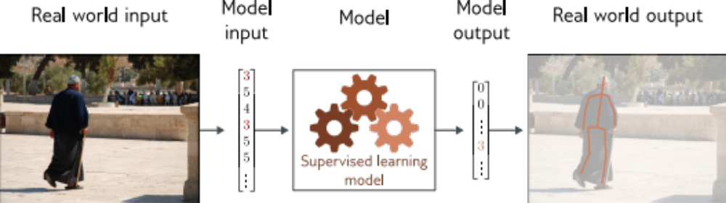
Pose estimation
Multivariate regression problem (many outputs, continuous)
Convolutional encoder-decoder network

Slide 26
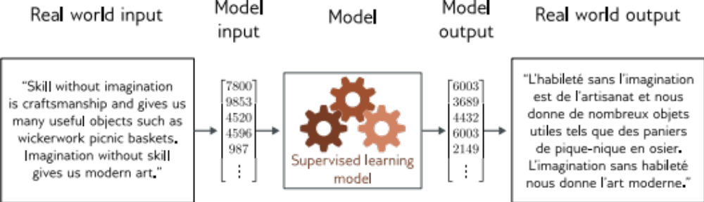
Translation

Slide 27
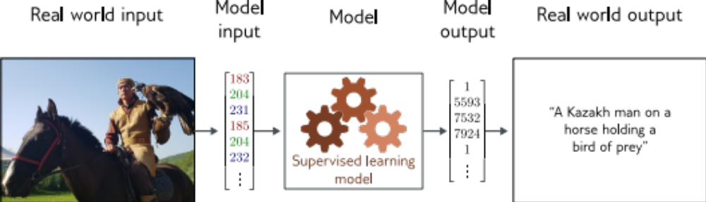
Image captioning

Slide 28
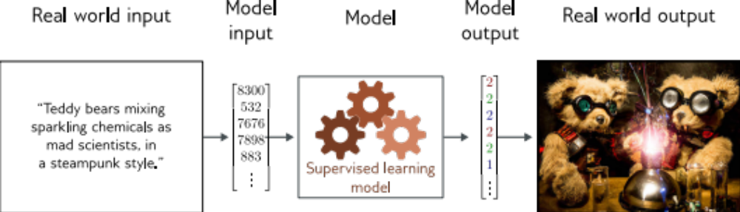
Image generation from text

Slide 29
What do these examples have in common?
Very complex relationship between input and output
Sometimes may be many possible valid answers
But outputs (and sometimes inputs) obey rules
Language obeys grammatical rules
Natural images also have “rules”
Notes:
Supervised learning: learn x → y
But y itself has structure. Can we learn that structure?
Unsupervised learning: learn structure from data

Slide 30
Credit: Simon J. D. Prince

Slide 31
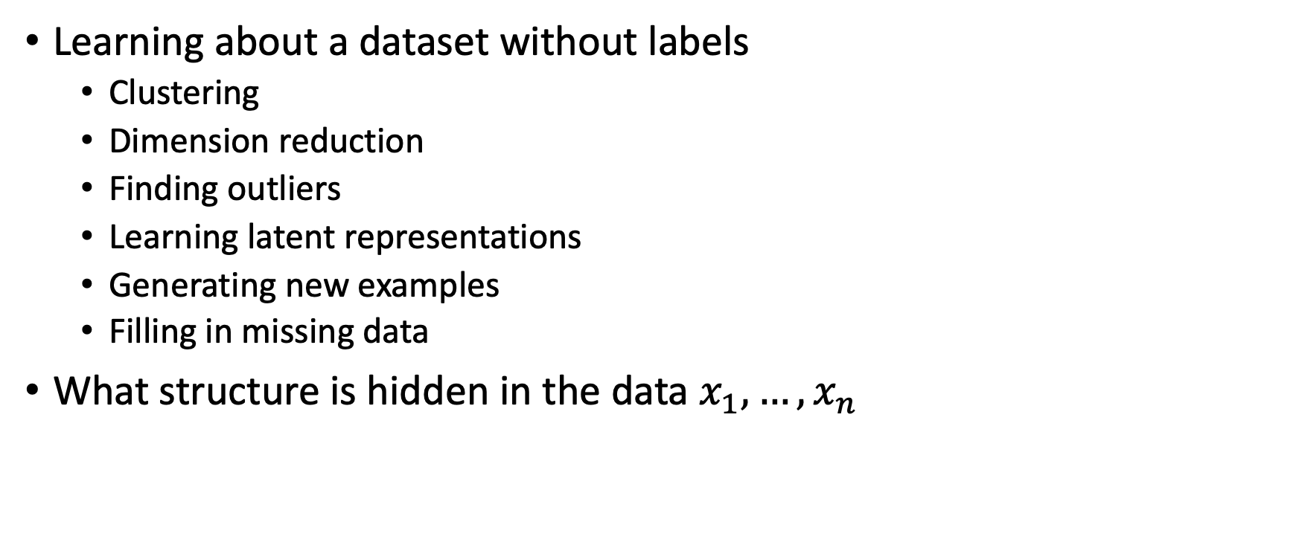
Unsupervised Learning
Learning about a dataset without labels
  Clustering
  Dimension reduction
  Finding outliers
  Learning latent representations
  Generating new examples
  Filling in missing data
What structure is hidden in the data $x_{1},…,x_{n}$

Slide 32
Unsupervised Learning
Learning about a dataset without labels
  e.g., clustering
Generative models can create examples
  e.g., generative adversarial networks
PGMs learn distribution over data
  e.g., variational autoencoders
  e.g., normalizing flows
  e.g., diffusion models
Notes:
A discriminative model often tries to answer a question such as:
“Given this image, is it a cat or a dog?”
A generative model asks a different question:
“What does the distribution of realistic images look like, and can I generate a new example from it?
We observe samples from some unknown data distribution. We do not know this distribution explicitly.
A generative model tries to learn enough about this distribution to create new samples that look as if they came from the same source.
There are many different ways to do this: GANs, variational autoencoders, normalizing flows, diffusion models.
You do not need to know what these are today. We will study several of them later in the semester.

Slide 33
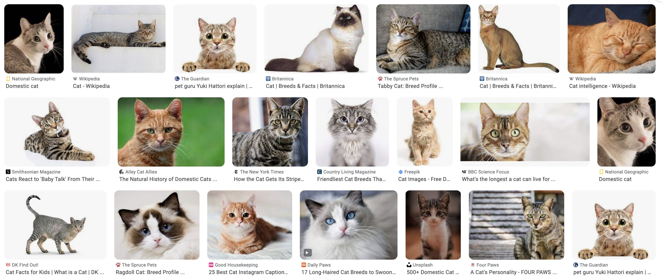
Generative models
Notes:
Cats have different colors, poses, backgrounds, sizes, and lighting.
So the goal is not to memorize one prototype cat.
The model has to learn what kinds of variations are plausible while still producing something that looks like a cat.

Slide 34
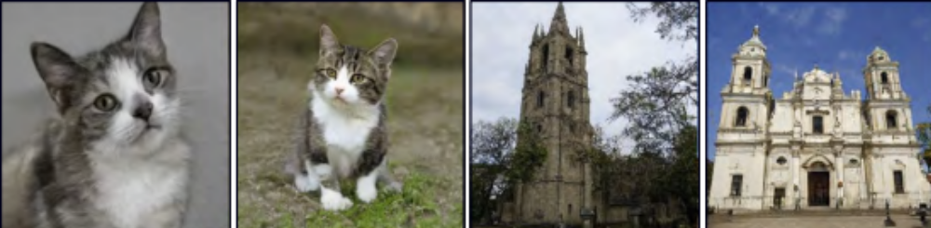
Generative models

Slide 35
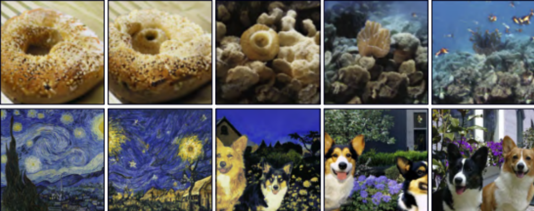
Interpolation

Slide 36
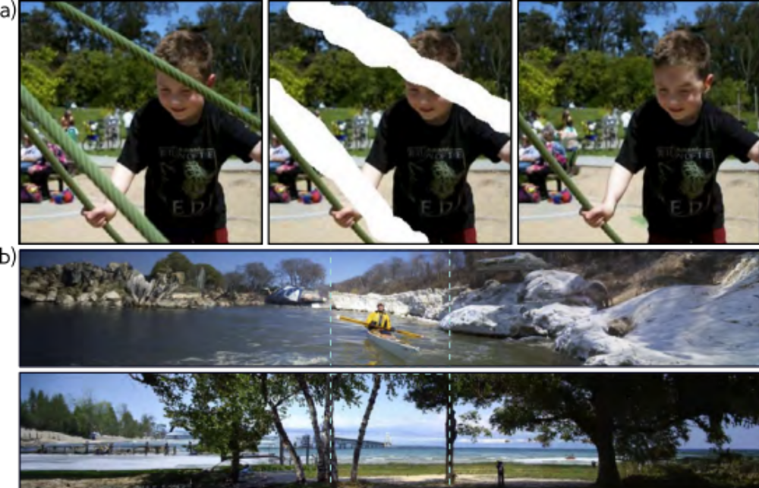
Conditional synthesis
Notes:
Inpainting: infer what could plausibly appear in the missing region
Modern diffusion models are extremely successful at this kind of conditional generation. We will study how they work later in the semester.

Slide 37
Credit: Simon J. D. Prince

Slide 38
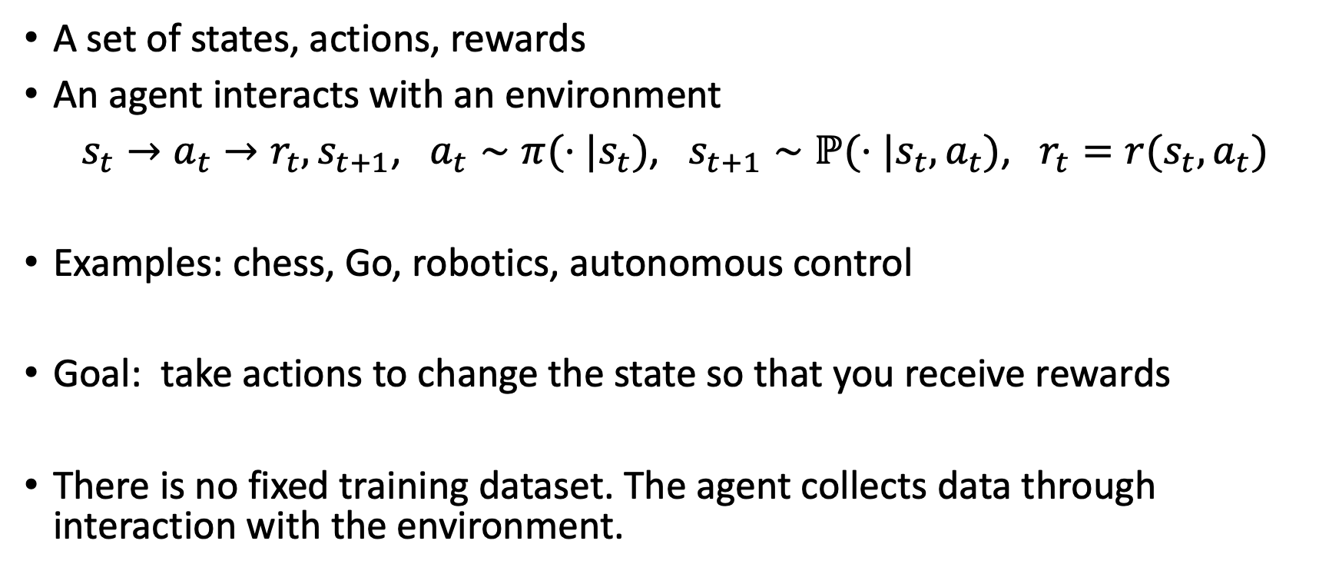
Reinforcement learning
A set of states, actions, rewards
An agent interacts with an environment
$s_{t}→a_{t}→r_{t},s_{t+1}$, $a_{t}∼π(⋅|s_{t})$, $s_{t+1}∼ℙ(⋅|s_{t},a_{t})$, $r_{t}=r(s_{t},a_{t})$
Examples: chess, Go, robotics, autonomous control
Goal: take actions to change the state so that you receive rewards
There is no fixed training dataset. The agent collects data through interaction with the environment.

Slide 39
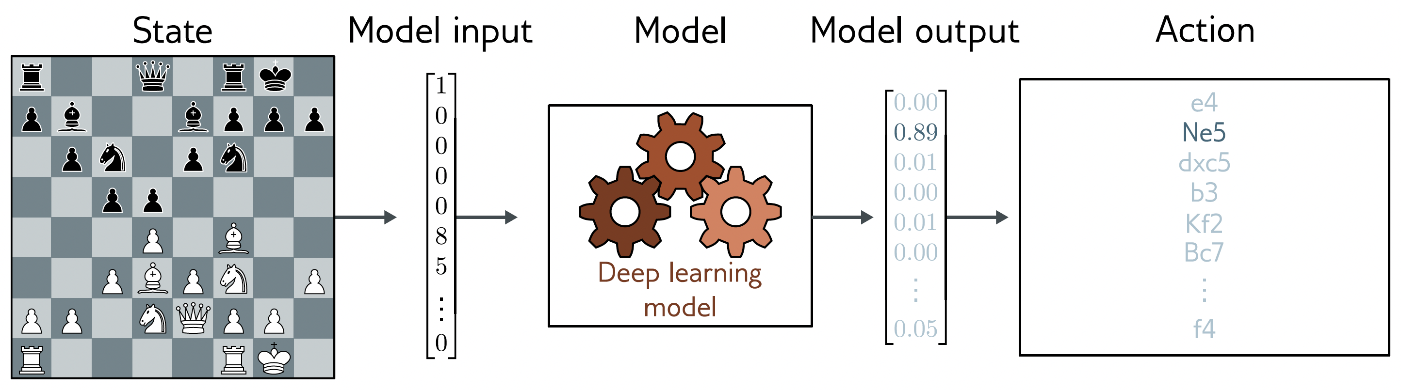
Example: chess
States are valid states of the chess board
Actions at a given time are valid possible moves
Positive rewards for taking pieces, negative rewards for losing them

Slide 40
Example: chess
States are valid states of the chess board
Actions at a given time are valid possible moves
Positive rewards for taking pieces, negative rewards for losing them

Slide 41
Why is this difficult?
Stochastic
  Make the same move twice, the opponent might not do the same thing
  Rewards also stochastic (opponent does or doesn’t take your piece)
Temporal credit assignment problem
  Did we get the reward because of this move? Or because we made good tactical decisions somewhere in the past?
Exploration-exploitation trade-off
  If we found a good opening, should we use this?
  Or should we try other things, hoping for something better?

Slide 42
Deep Learning

Slide 43
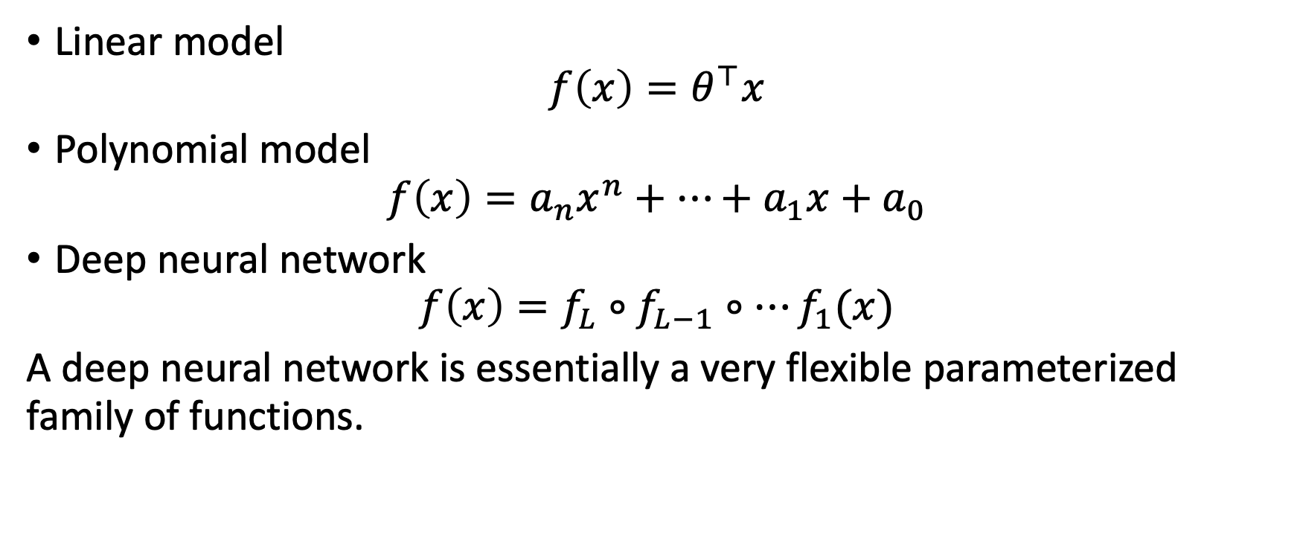
Family of functions
Linear model
$$f\left(x\right)=θ^{⊤}x$$
Polynomial model
$$f\left(x\right)=a_{n}x^{n}+…+a_{1}x+a_{0}$$
Deep neural network
$$f\left(x\right)=f_{L}∘f_{L−1}∘…f_{1}(x)$$
A deep neural network is essentially a very flexible parameterized family of functions.

Slide 44
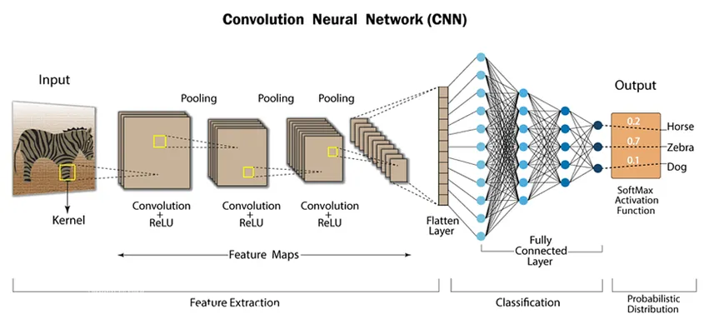
Examples
CNN (Convolutional Neural Network) for image classification

Slide 45
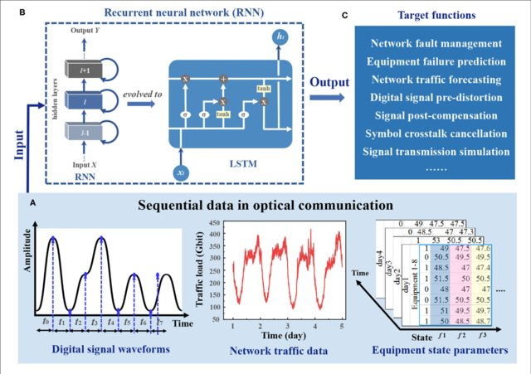
Examples
RNN (Recurrent Neural Network) for sequential data (e.g. time series)

Slide 46
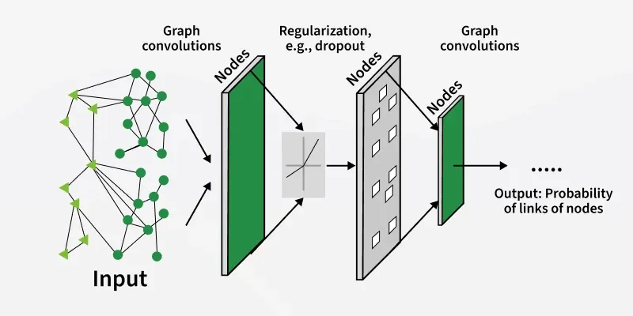
Examples
GNN (Graph Neural Network) for graphs (e.g. social networks)

Slide 47
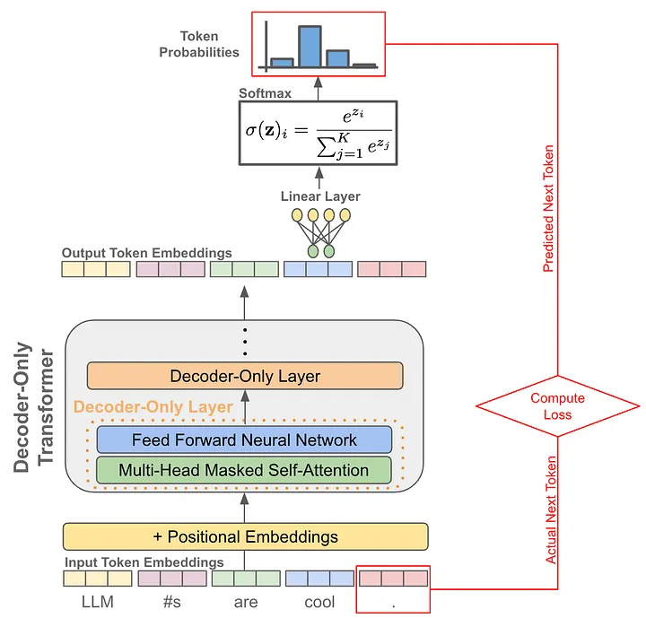
Examples
Transformer for next-token prediction

Slide 48
ML Theory Overview

Slide 49
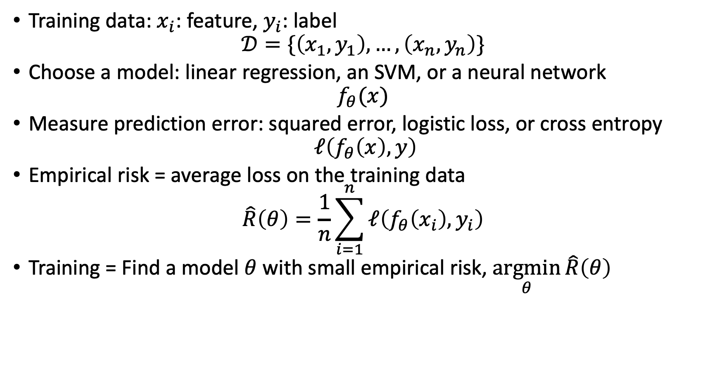
Learning from data
Training data: $x_{i}$: feature, $y_{i}$: label
$$𝒟=\{\left(x_{1},y_{1}\right),…,\left(x_{n}, y_{n}\right)\}$$
Choose a model: linear regression, an SVM, or a neural network
$$f_{θ}(x)$$
Measure prediction error: squared error, logistic loss, or cross entropy
$$ℓ\left(f_{θ}\left(x\right),y\right)$$
Empirical risk = average loss on the training data
$$\hat{R}\left(θ\right)=\frac{1}{n}\sum_{i=1}^{n}{ℓ\left(f_{θ}\left(x_{i}\right),y_{i}\right)}$$
Training = Find a model $θ$ with small empirical risk, $\underset{θ}{argmin}{\hat{R}\left(θ\right)}$

Slide 50
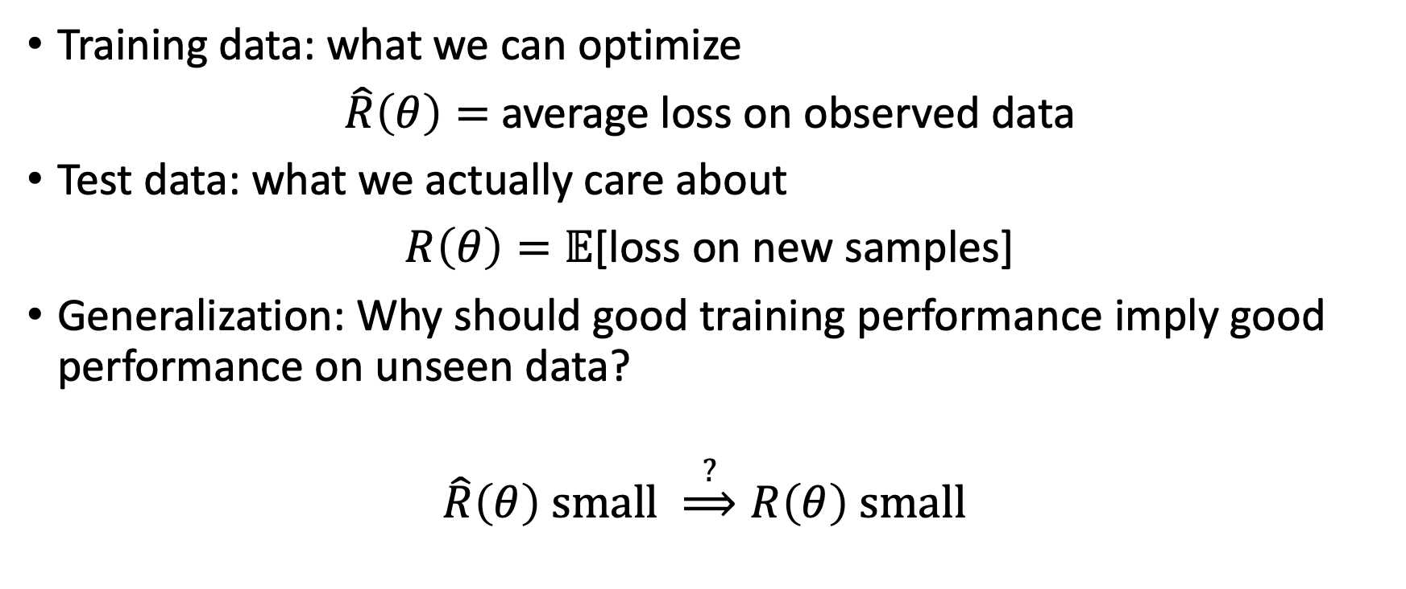
Training Error ≠ Test Error
Training data: what we can optimize
$\hat{R}\left(θ\right)=$ average loss on observed data
Test data: what we actually care about
$R\left(θ\right)=𝔼$[loss on new samples]
Generalization: Why should good training performance imply good performance on unseen data?
$$\hat{R}\left(θ\right) small \overset{?}{⟹}R\left(θ\right) small$$

Slide 51
Three questions behind ML
Modeling: is the model expressive enough?
  Linear model, kernel model, neural network
Optimization: can we train the model efficiently?
  Gradient descent, SGD, momentum, backpropagation
Generalization: will it work on unseen data?
  Overfitting, regularization, overparameterization
ML theory ≈ modeling + optimization + generalization

Slide 52
What’s next?
A repeating template
  What is the prediction task?
  What model do we use?
  What loss do we minimize?
  How do we train the model?
  Why should it generalize?
Next lecture: Linear Regression
  Linear model + squared loss → least squares

Slide 53
Thank you!

